Slide 1




Making Games
More Interactive
on Twitch
#twitchmygame
Richard Deveraux
@lowlines

Slide 2


Background…
Web Developer 7+ years
Made web tools & guides for games
Heavily involved in the Destiny and Battleborn communities
Maintained the unofficial Bungie API docs
Contracted by Gearbox Software to help build the Borderlands 3 ECHOcast Twitch Extension
Recently moved to Melbourne from Darwin to be more involved in the Aussie indie scene!
Worked with Tinman and Ghost Pattern to build websites for their games!
#twitchmygame
Richard Deveraux
@lowlines

Slide 3

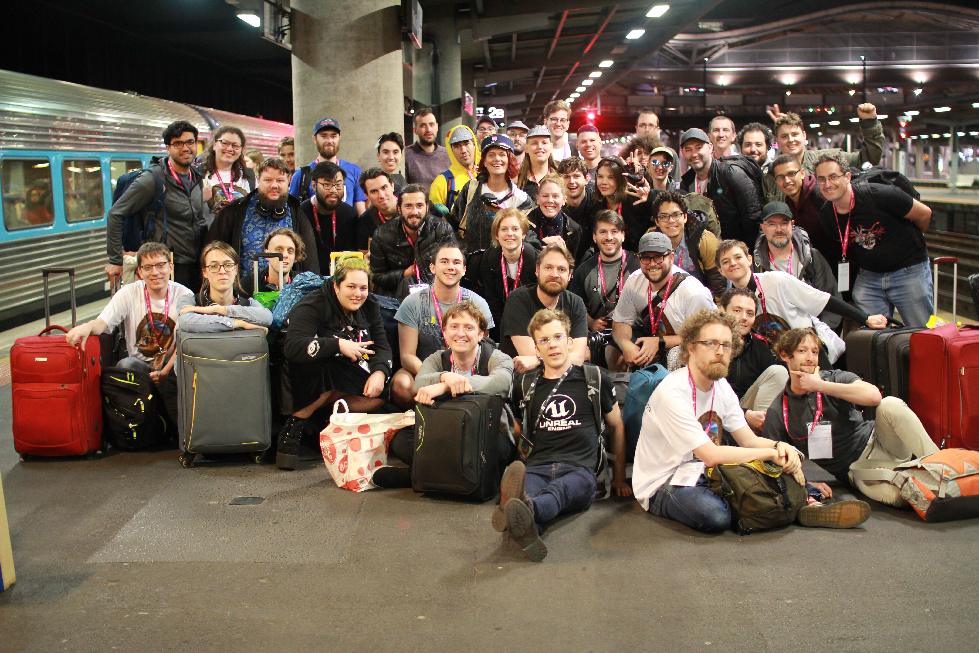
Background…
…survived the first ever LocomoJam from Brisbane to Melbourne via Sydney!
#twitchmygame
Richard Deveraux
@lowlines

Slide 4
Disclaimer
I do not speak for or represent Gearbox Software, 2K Games or Twitch.
ECHOcast Interview with goto.game https://goto.game/interview-richard-deveraux-talks-echocast/
TwitchCon! Keynote Spot - https://www.twitch.tv/videos/487075225?t=69m42s ECHOcast Roundtable - https://www.twitch.tv/videos/487593356?t=17241s
BorderCast Interview - https://www.twitch.tv/videos/487121734?t=17875s
#twitchmygame
Richard Deveraux
@lowlines
Notes:
Got permission to do this talk, but obviously can’t go into too much detail about the ECHOcast.

Slide 5
Overview
Timeline of Twitch Extensions
Games that have interactivity
Streamer vs Viewers; building games played while streaming
Q&A / Extension Challenge?
#twitchmygame
Richard Deveraux
@lowlines
Notes:
What worked well, what didn’t, and suggestions on how Twitch Extensions could help fix issues faced

Slide 6


Timeline
#twitchmygame
Richard Deveraux
@lowlines
Notes:
Twitch introduced in June 2011 as a spin-off of Justin.tv

Slide 7
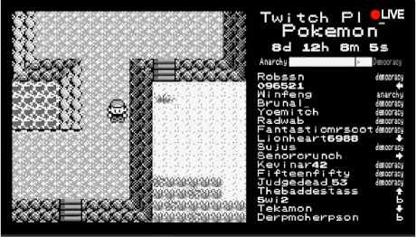

Timeline cont.
https://en.wikipedia.org/wiki/File:Twitch_plays_pokemon_animated.gif
#twitchmygame
Richard Deveraux
@lowlines
Notes:
On 12 February 2014, and Aussie programmer launched a channel that allowed chat to control a modded version of Pokemon Red running on an emulator known as Twitch Plays Pokemon. I’m sure everyone in this room has at least heard of. (Praise the Helix)

Slide 8


Timeline cont.
https://blog.twitch.tv/en/2017/08/31/introducing-extensions-a-streaming-revolution-c31762addcd9/
#twitchmygame
Richard Deveraux
@lowlines
Notes:
Some time late 2017, Twitch released their Extensions platform touting it to be the future of streaming

Slide 9
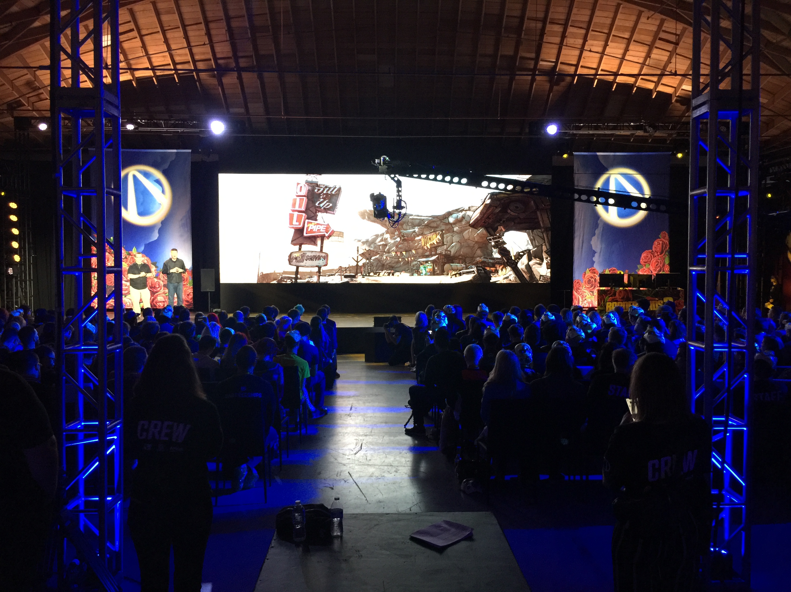
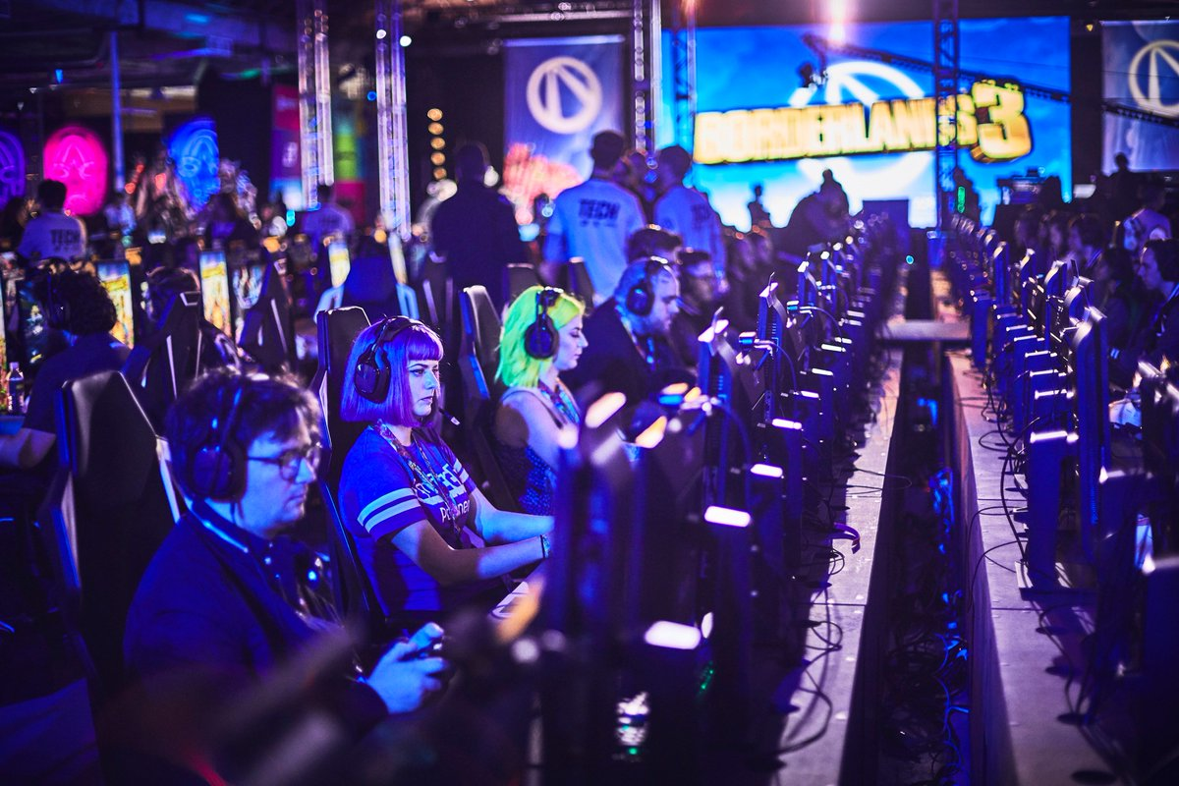
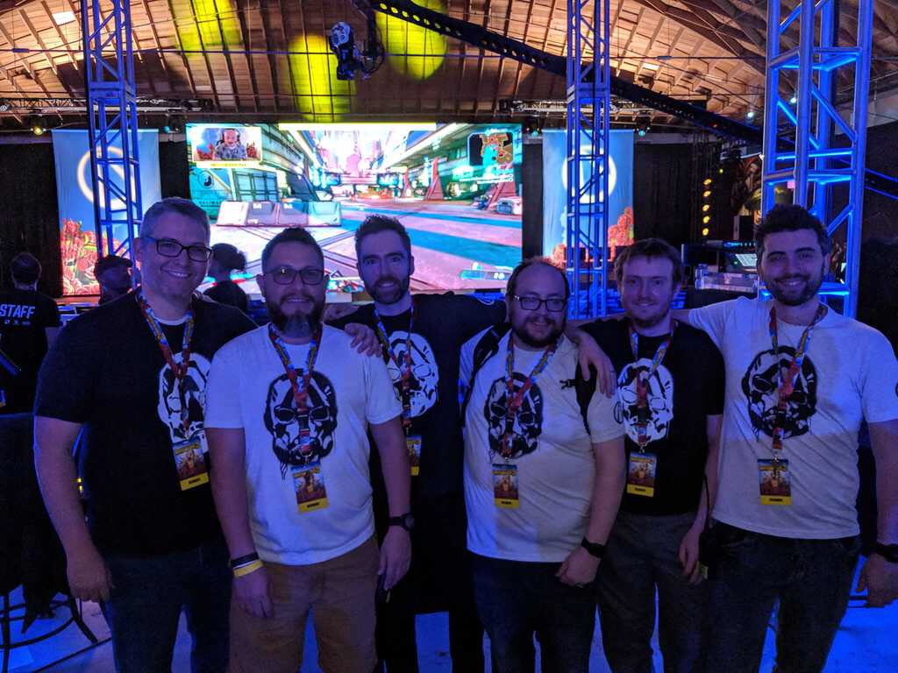
Timeline cont.
https://borderlands.com/en-US/news/2019-04-29-score-loot-with-twitch-during-gameplay-reveal/
#twitchmygame
Richard Deveraux
@lowlines
Notes:
On May 1, 2019, Gearbox hosted a Borderlands 3 gameplay reveal in LA with 200 gaming PCs capable of streaming.

Slide 10
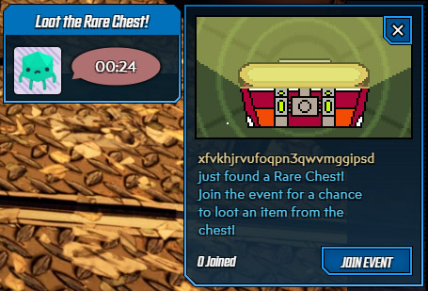
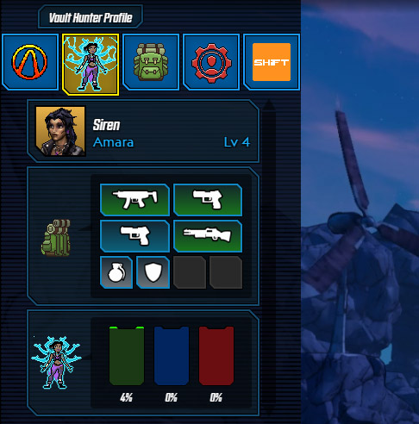
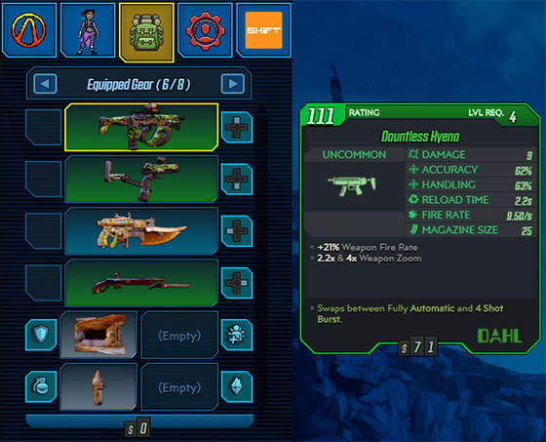
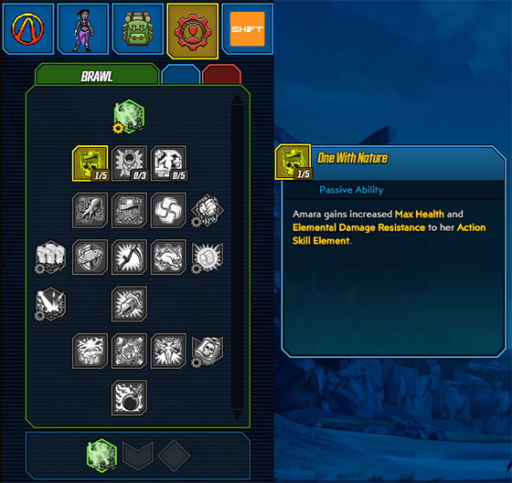
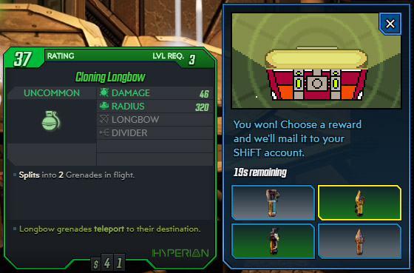
Timeline cont.
https://borderlands.com/en-US/news/2019-04-29-score-loot-with-twitch-during-gameplay-reveal/
#twitchmygame
Richard Deveraux
@lowlines
Notes:
We also launched v1 of the ECHOcast Twitch Extension.

Slide 11
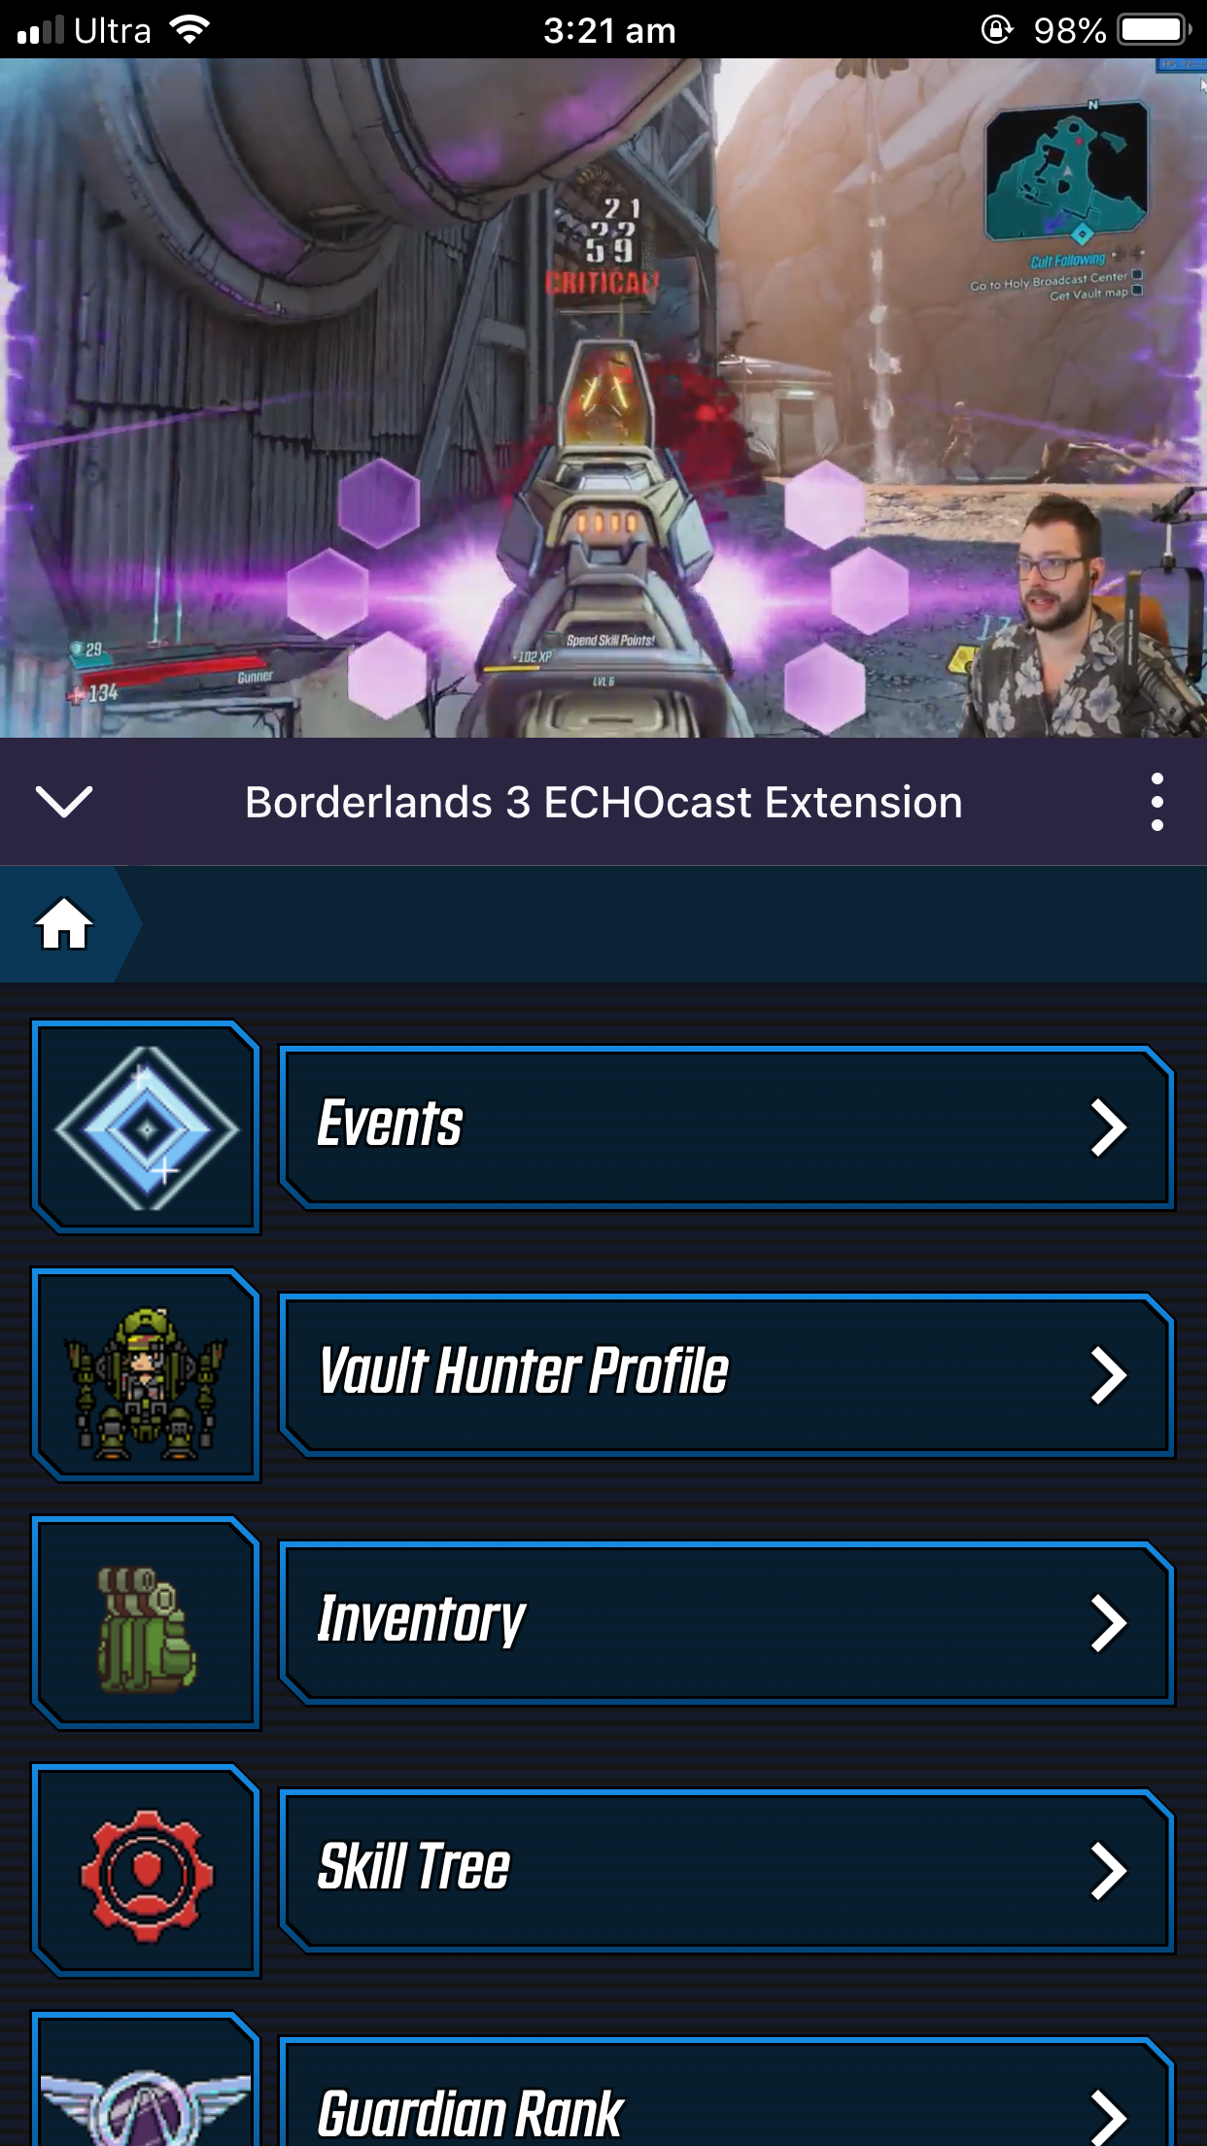
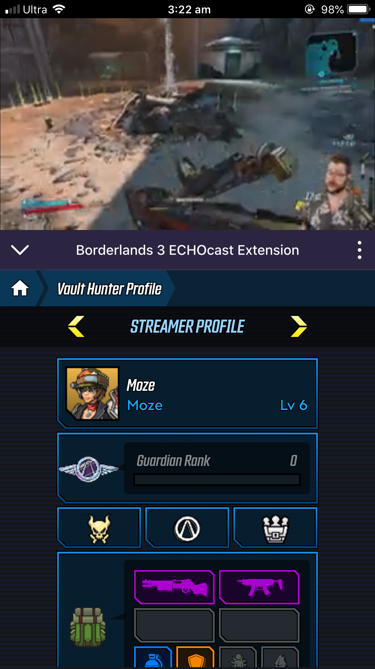
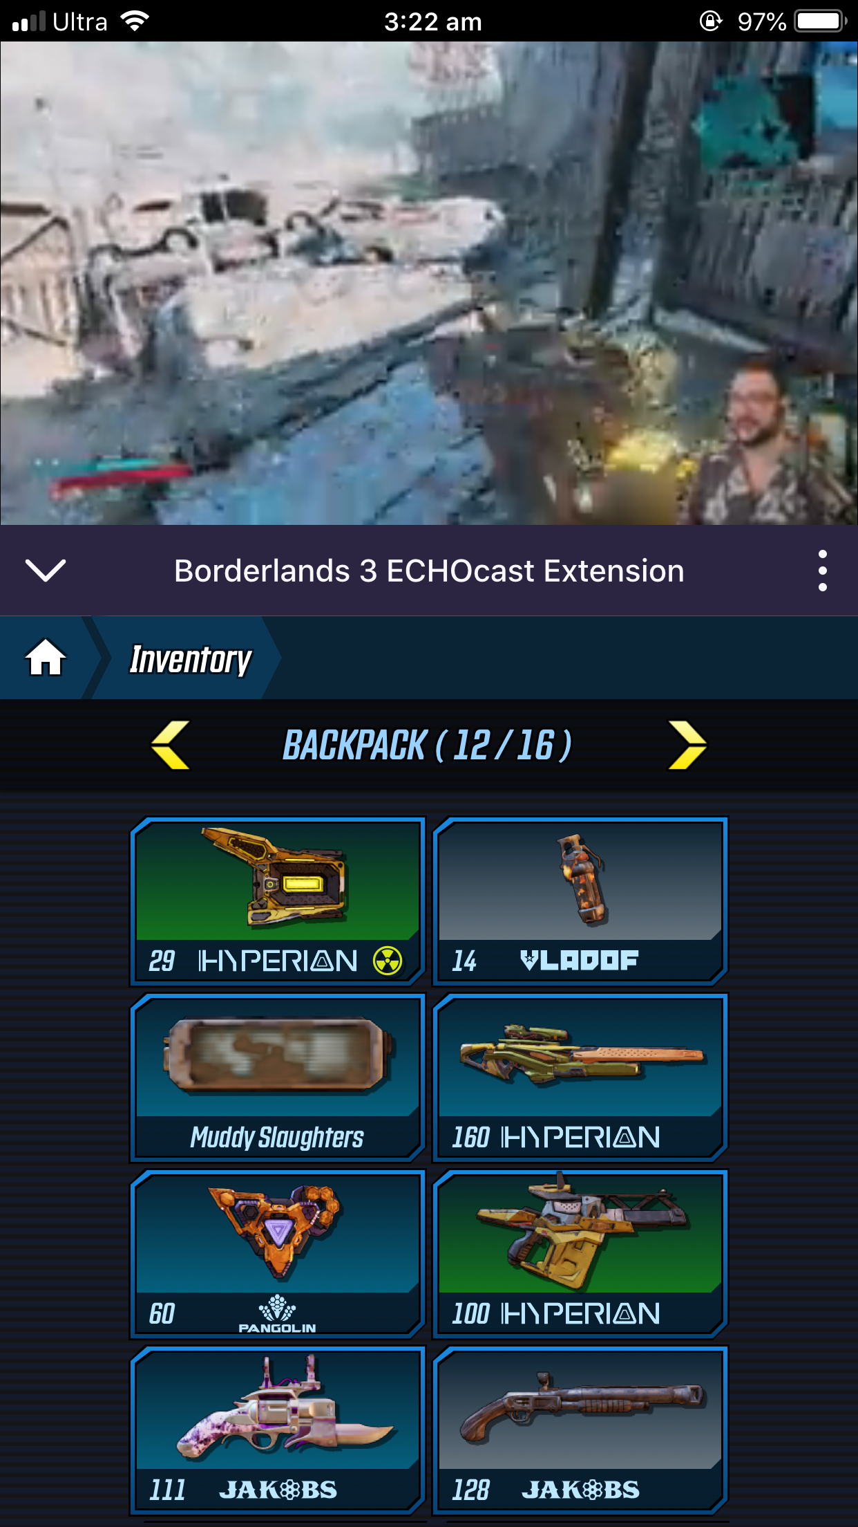
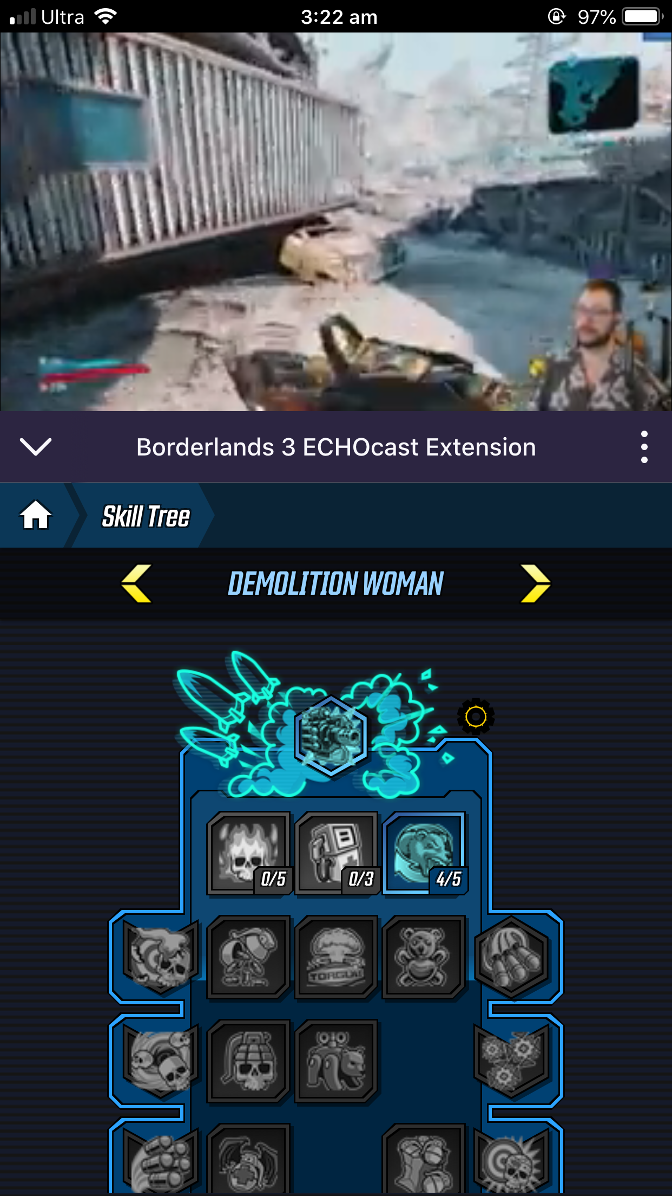
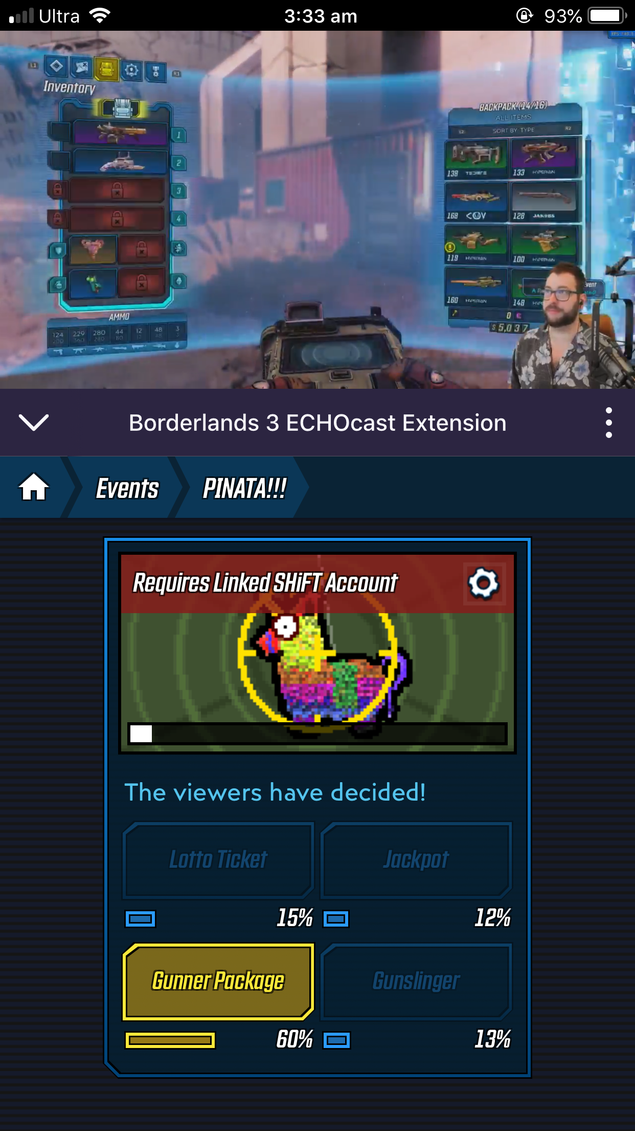
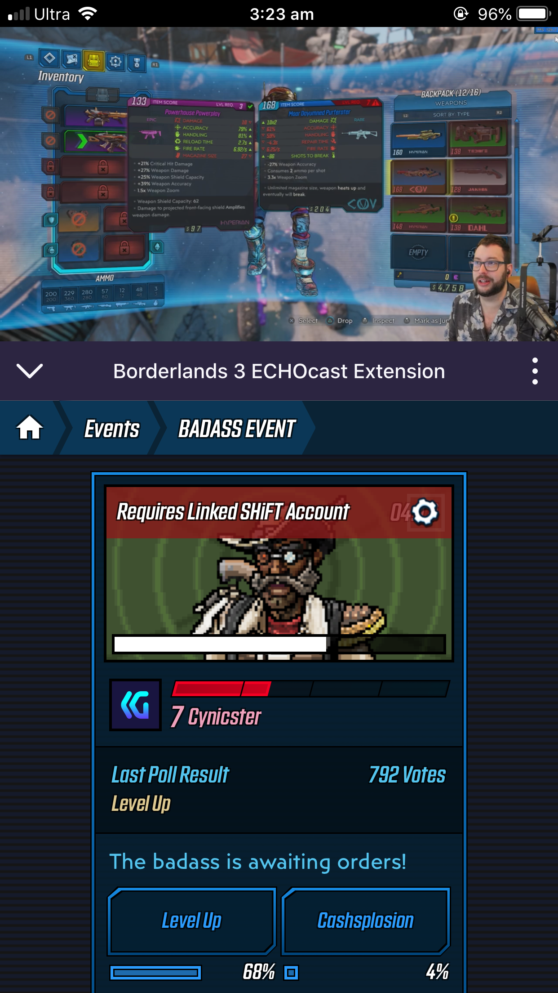
Timeline cont.
https://www.youtube.com/watch?v=lDoXKH9RqZg
#twitchmygame
Richard Deveraux
@lowlines
Notes:
Finally on September 13, 2019, Borderlands 3 launched along with the ECHOcast allowing anyone to use the extension. (It has been pretty popular!)

Slide 12
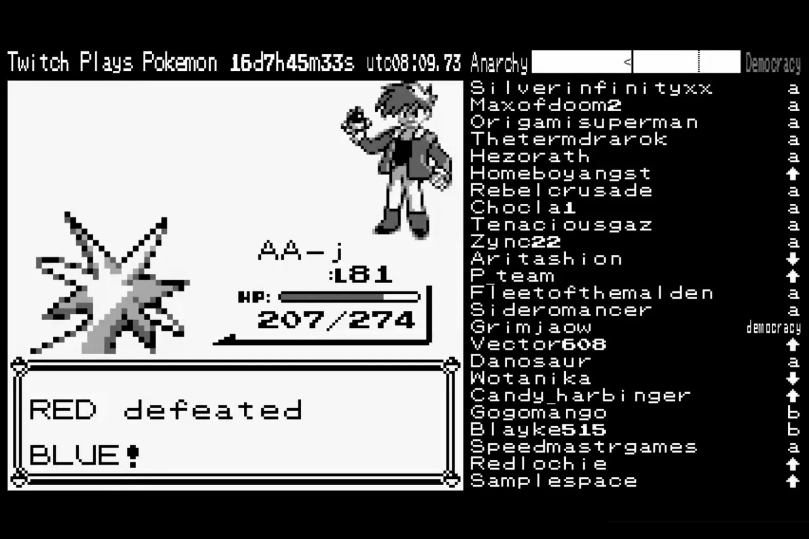


Timeline cont.
06/2011
02/2014
2017
05/2019
09/2019
#twitchmygame
Richard Deveraux
@lowlines
Notes:
This is not a definitive timeline, but it highlights some of the key events that (in my opinion) have helped shape the evolution of Twitch.

Slide 13
Twitch Plays Pokemon
#twitchmygame
Richard Deveraux
@lowlines
Notes:
Social experiment
Wikipedia - “The stream became unexpectedly popular, reaching an average concurrent viewership of over 80,000 viewers (with at least 10% participating). On 1 March 2014, the game was completed after more than 16 continuous days of gameplay; Twitch estimated that over 1.16 million people participated, with peak simultaneous participation at 121,000, and with a total of 55 million views during the experiment”

Slide 14
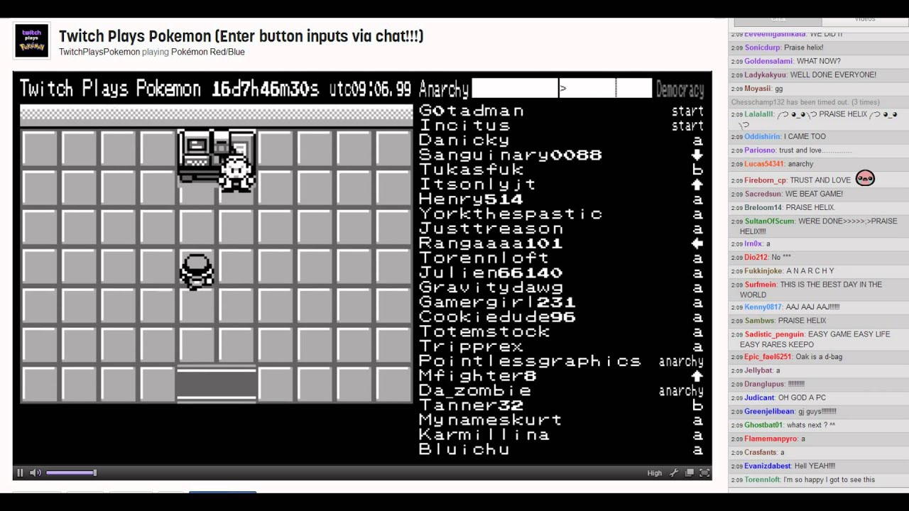
Twitch Plays Pokemon
https://www.youtube.com/watch?v=WPuQSkz8ZDA
#twitchmygame
Richard Deveraux
@lowlines
Notes:
At the time the only way you could interact with the stream was writing a bot that would scrape the chat for commands. This meant the chat became unusable and while eventually this interface was moved to an IRC chat, it meant viewers had to go the extra mile in order to participate

Slide 15

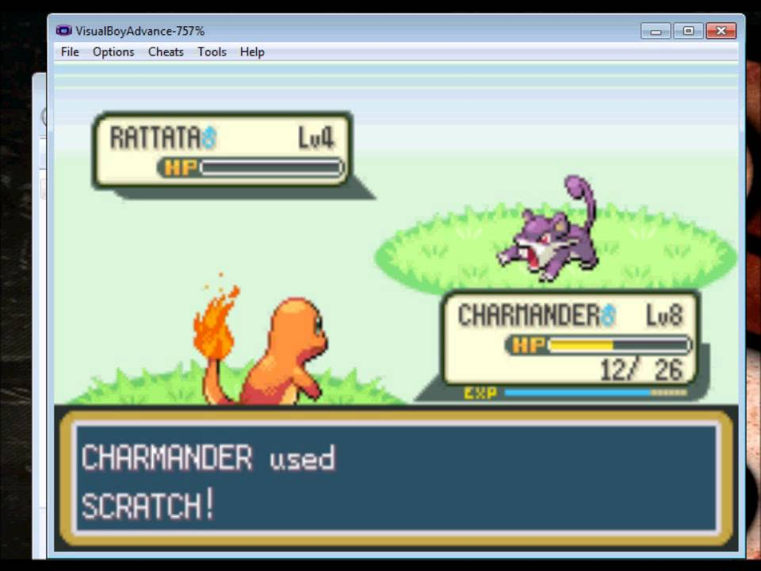
Twitch Plays Pokemon
#twitchmygame
Richard Deveraux
@lowlines
Notes:
It also required a modded version of the game running on an emulator so the streamer also needed to know how to set this up! This set a precedent that if Twitch wasn’t already working towards, probably pushed them to start working on their Extensions platform!

Slide 16

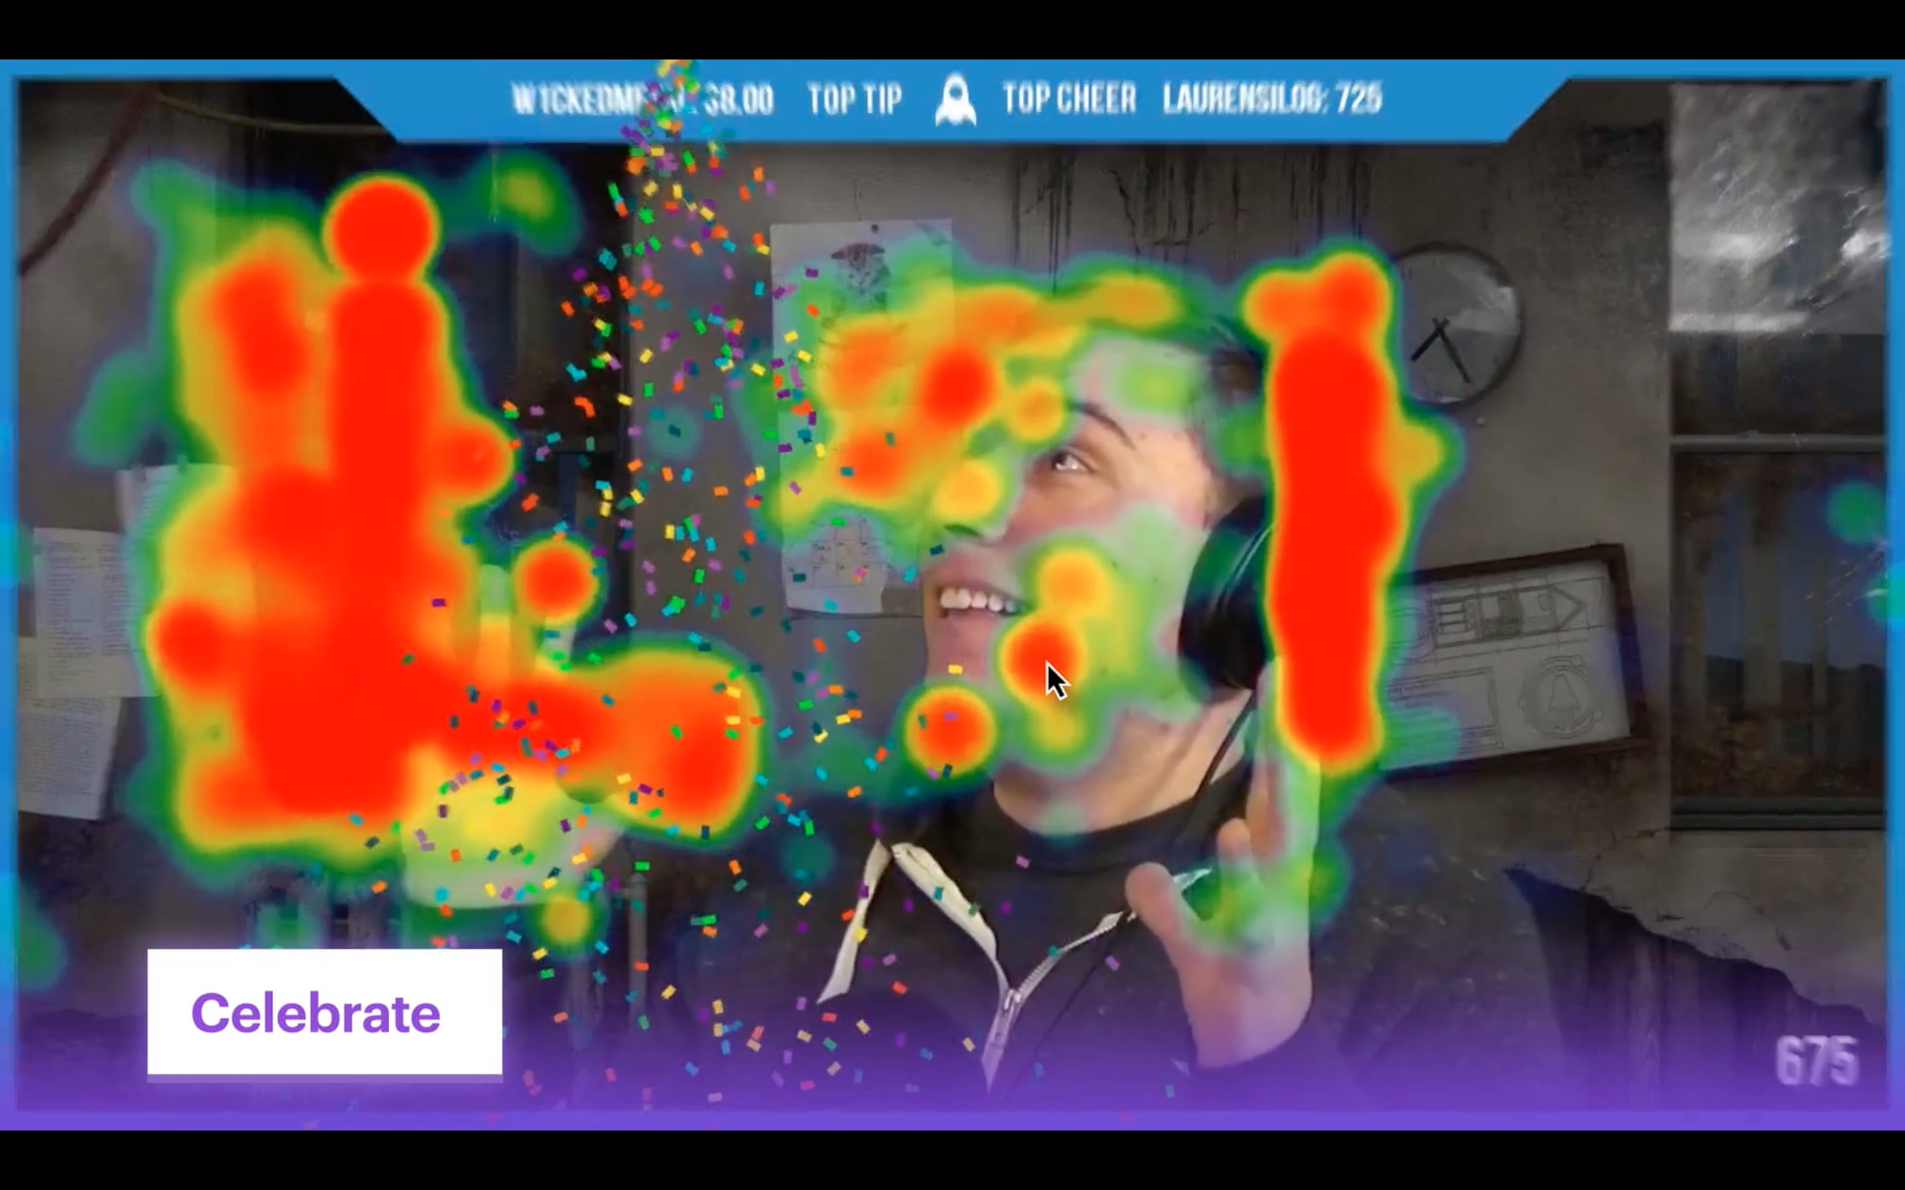
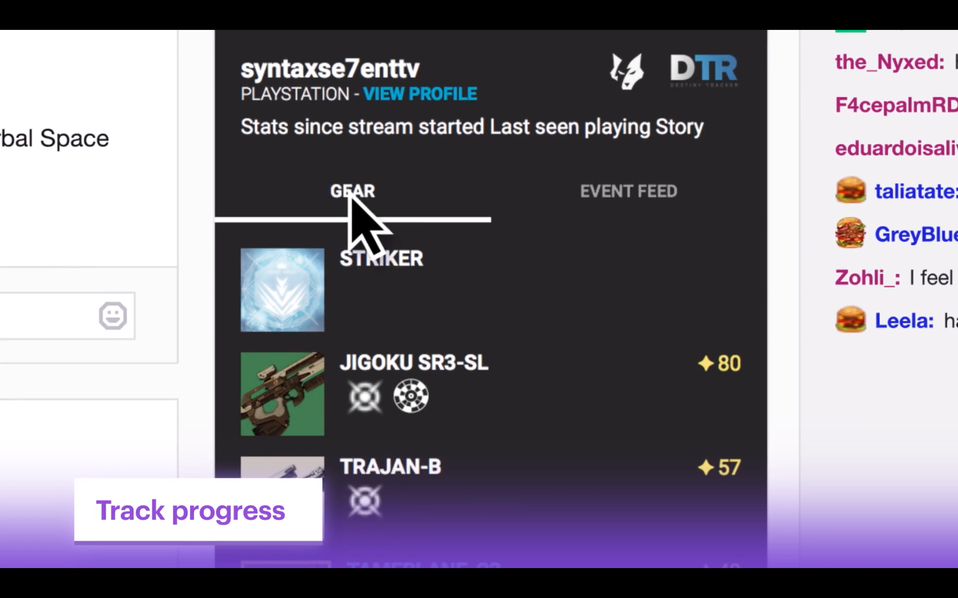
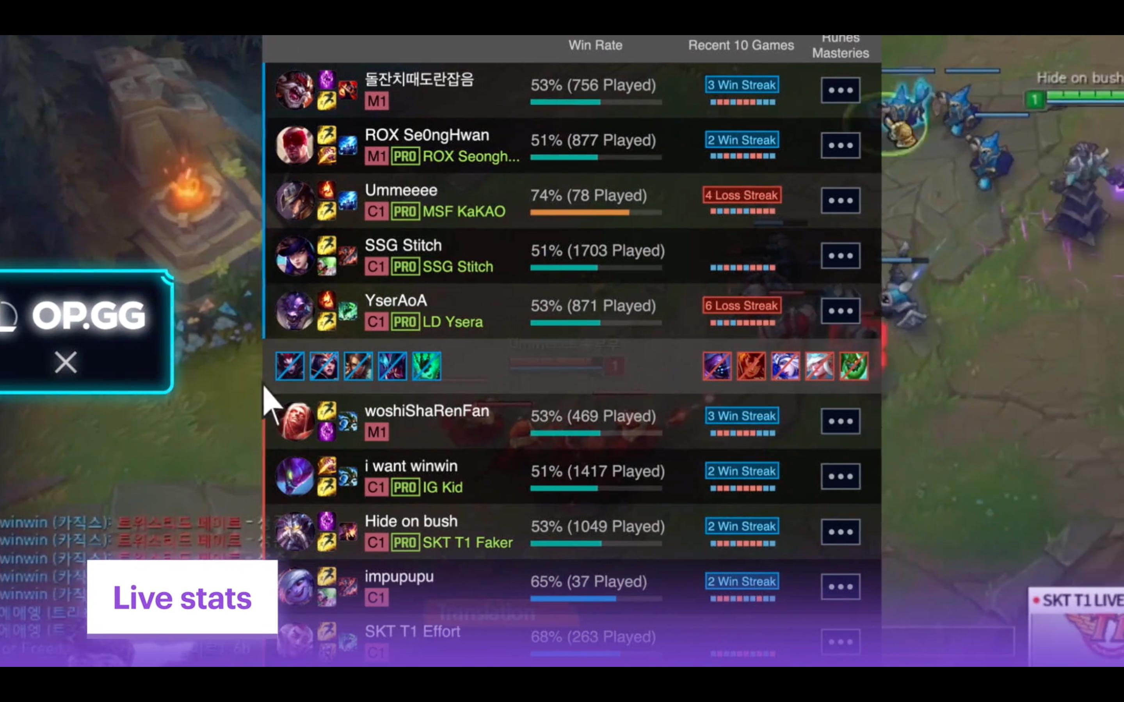
The Streaming Revolution
https://blog.twitch.tv/en/2017/08/31/introducing-extensions-a-streaming-revolution-c31762addcd9/
#twitchmygame
Richard Deveraux
@lowlines
Notes:
Twitch created a way for developers to overlay streams with custom UI
Combined with their APIs, there was now an official way to add interactivity to streams that wasn’t possible before.

Slide 17





The Streaming Revolution
https://twitchdevjam.devpost.com/details/resources
#twitchmygame
Richard Deveraux
@lowlines
Notes:
Unfortunately that was only one part of the problem, games still needed to be modded in order to fully utilize extensions or have an API that extension developers could use to bridge the gap
There are very few games that have public APIs (most are AAA titles)

Slide 18

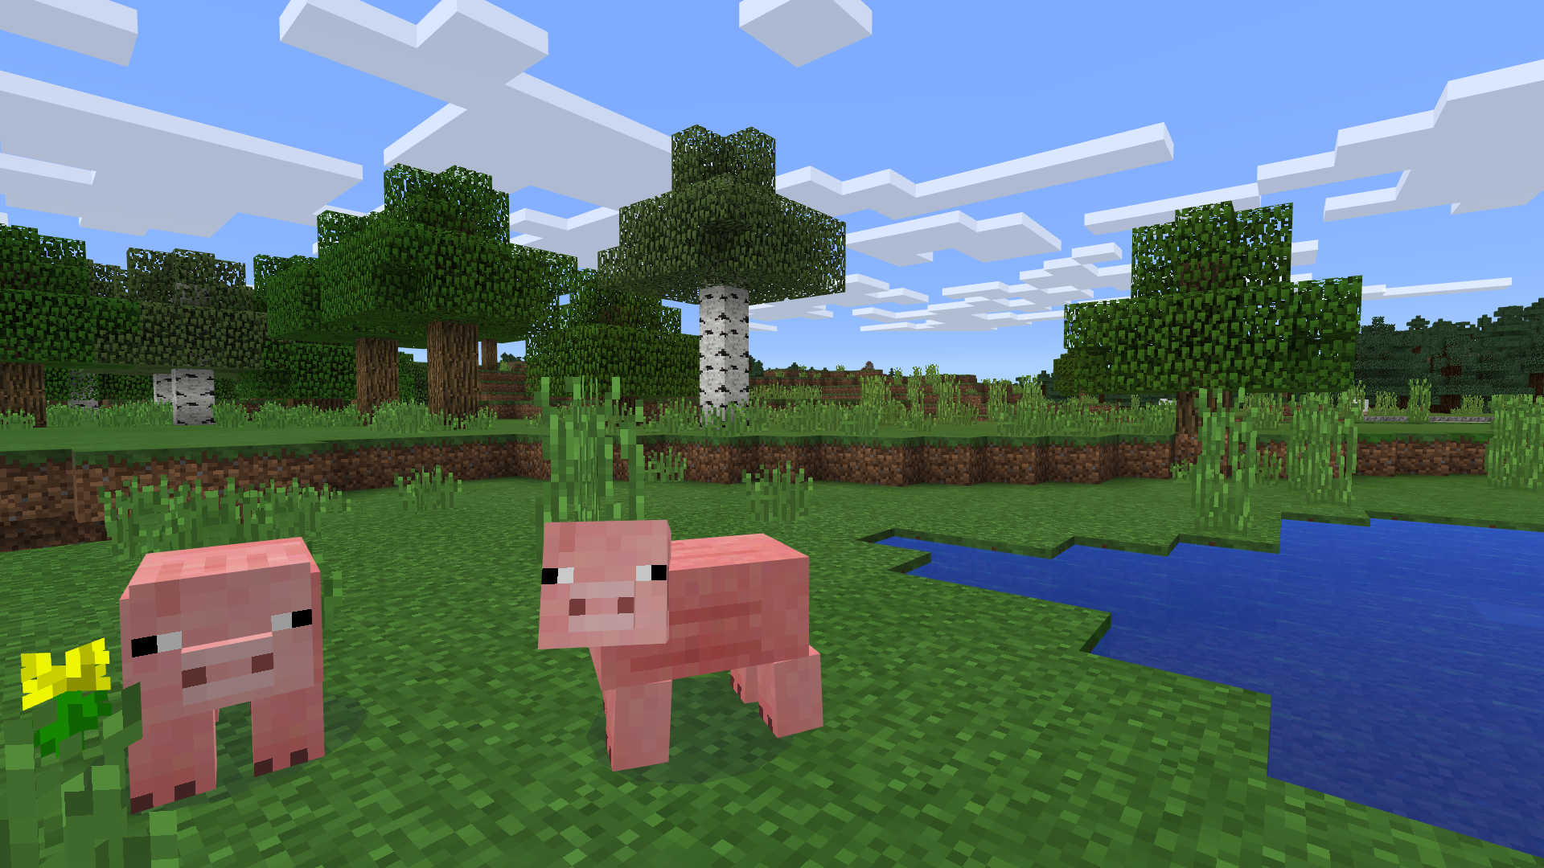
The Streaming Revolution
#twitchmygame
Richard Deveraux
@lowlines
Notes:
There are tons of game mods, but modding is still typically limited to PC (no consoles)

Slide 19

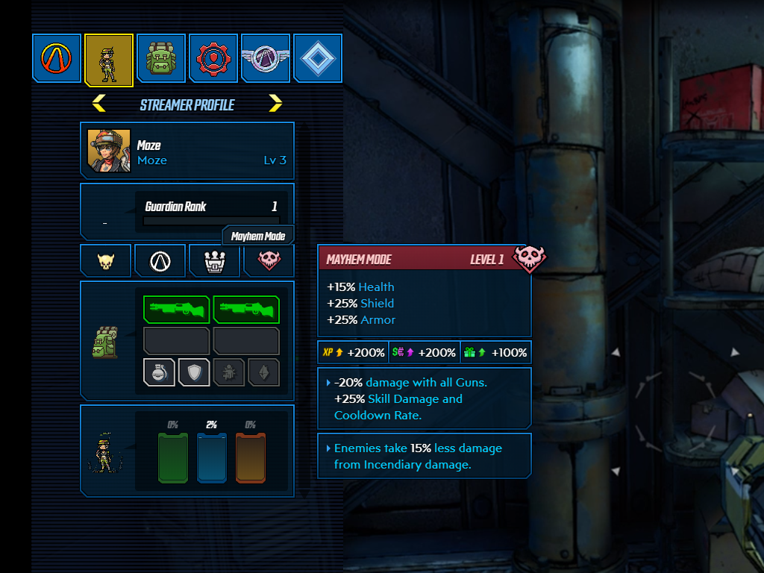
Let’s Make Some Mayhem
https://www.twitch.tv/ext/07kczqwdkjxw6la4j92crc5wyumjxa
#twitchmygame
Richard Deveraux
@lowlines
Notes:
Borderlands 3 has dedicated support for Twitch integration that was a cumulative effort between game programmers, online services and contracted frontend web developers.

Slide 20

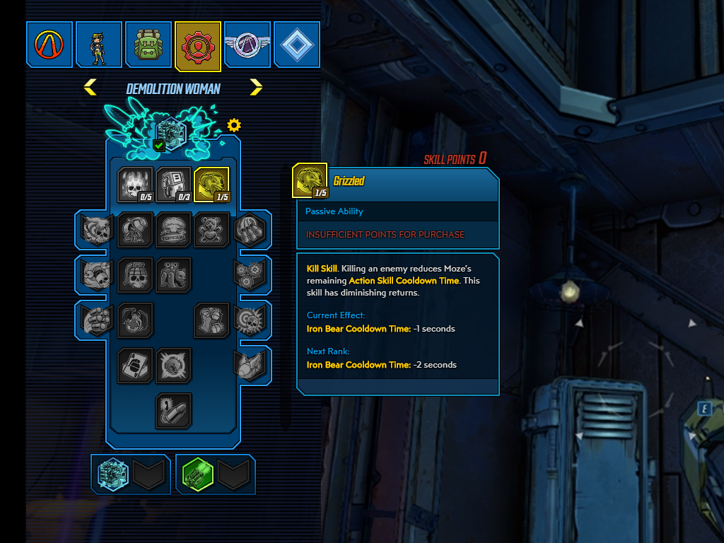
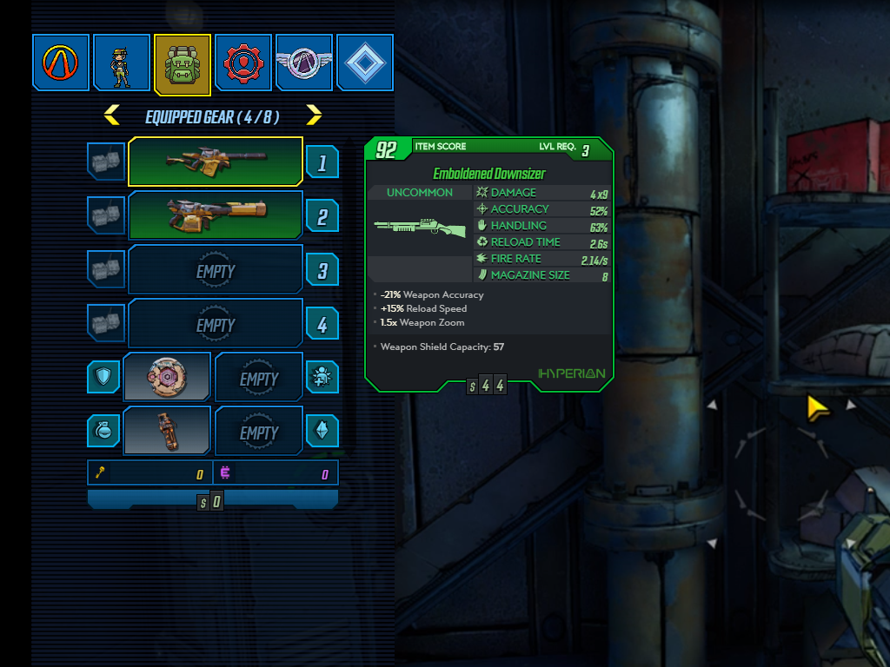
Let’s Make Some Mayhem
https://www.twitch.tv/ext/07kczqwdkjxw6la4j92crc5wyumjxa
#twitchmygame
Richard Deveraux
@lowlines
Notes:
View the streamer’s profile info, let the streamer concentrate on playing and not have to constantly stop to show their gear and stats to their viewers

Slide 21
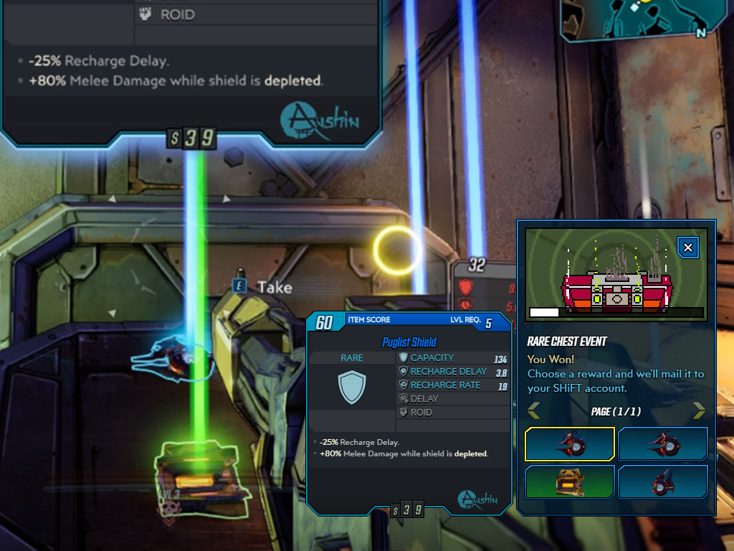
Let’s Make Some Mayhem
https://www.twitch.tv/ext/07kczqwdkjxw6la4j92crc5wyumjxa
#twitchmygame
Richard Deveraux
@lowlines
Notes:
Rare Chest Event; Streamer opens a chest, viewers go into a raffle for a chance to earn a copy of the loot (scaled to their character’s level) where 25% of viewers have a chance to win

Slide 22
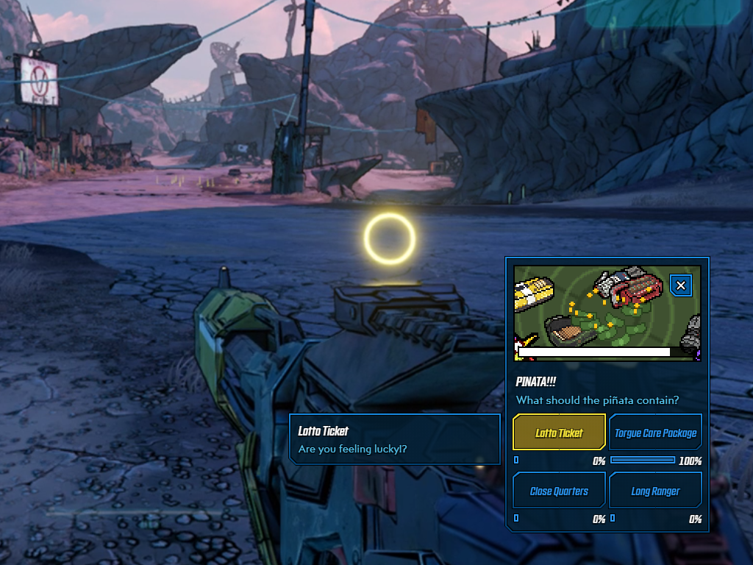
Let’s Make Some Mayhem
https://www.twitch.tv/ext/07kczqwdkjxw6la4j92crc5wyumjxa
#twitchmygame
Richard Deveraux
@lowlines
Notes:
Pinata Event; Every time the streamer levels up, a Pinata spawns and the viewers can vote on what it contains (they like to troll with grenades)

Slide 23
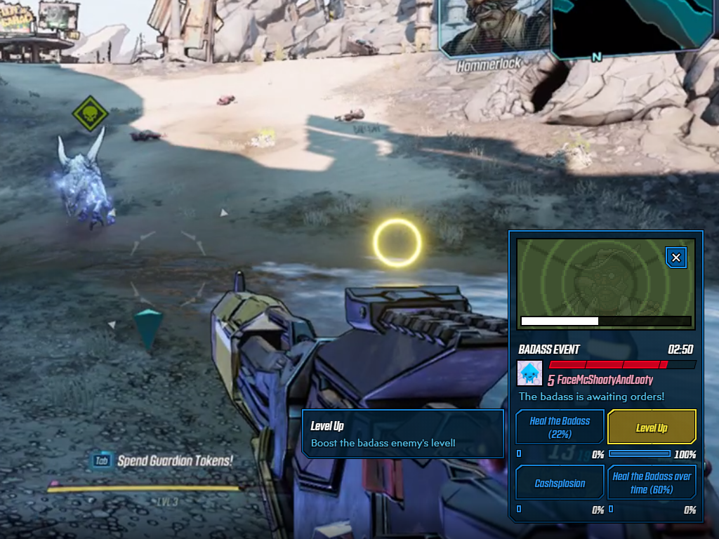
Let’s Make Some Mayhem
https://www.twitch.tv/ext/07kczqwdkjxw6la4j92crc5wyumjxa
#twitchmygame
Richard Deveraux
@lowlines
Notes:
Badass Viewer Event; One viewer gets chosen to spawn as a named badass enemy in the streamer’s game. Viewers can vote on actions to aid the badass that can actually turn it into a real challenge for streamers (especially the healing)

Slide 24

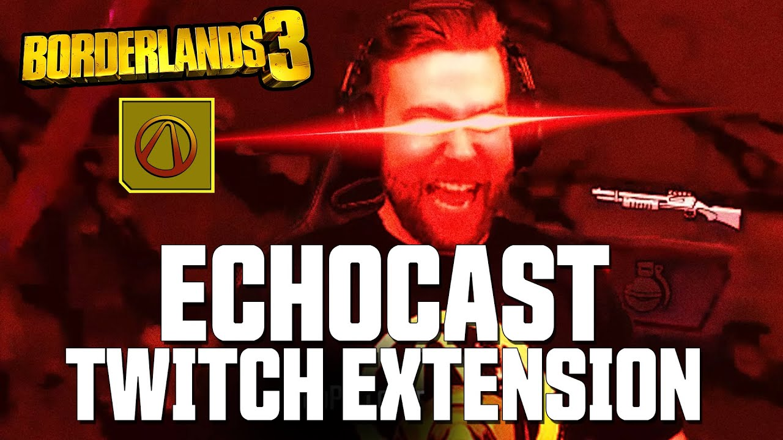
Let’s Make Some Mayhem
https://www.youtube.com/watch?v=lDoXKH9RqZg
#twitchmygame
Richard Deveraux
@lowlines
Notes:
These interactive events have been really popular and have actually increased how long viewers stay watching a stream.

Slide 25

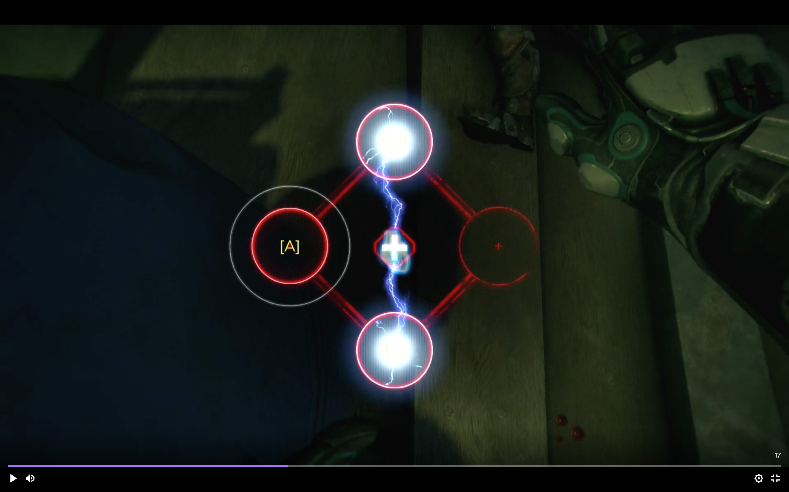
Rage 2 - Defibrillator
https://twitter.com/rage/status/1128724989144911872
#twitchmygame
Richard Deveraux
@lowlines
Notes:
Launched with an extension that let viewers revive the streamer when they were downed by participating in a mini-game
I thought it was really cool, but it didn’t take into account the fact that streamers are typically good players and so dying wouldn’t happen often
The viewer experience was not well polished and the messaging around installing and using the extension was not clear
It also played sound effects! :S

Slide 26

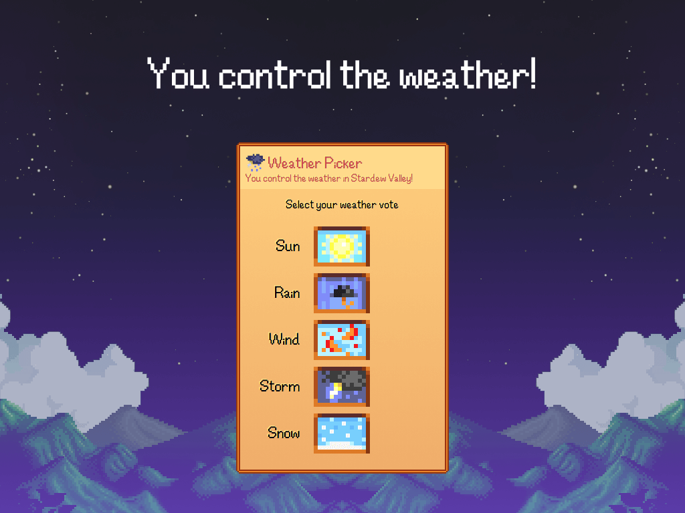
Stardew Valley Weather
https://www.twitch.tv/ext/n7tl4s82j4t7ukowth87p6azvjz0cf
#twitchmygame
Richard Deveraux
@lowlines
Notes:
Allows viewers to control the weather in the streamer’s game
It gives viewers some control over the experience however probably not enough?

Slide 27

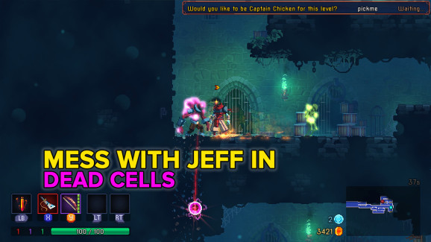
Dead Cells (Twitch Chat API)
https://venturebeat.com/2018/08/07/dead-cells-twitch-integration-is-great/
#twitchmygame
Richard Deveraux
@lowlines
Notes:
Released before Twitch Extensions but offered interactivity via chat
- Actually did some really cool stuff

Slide 28

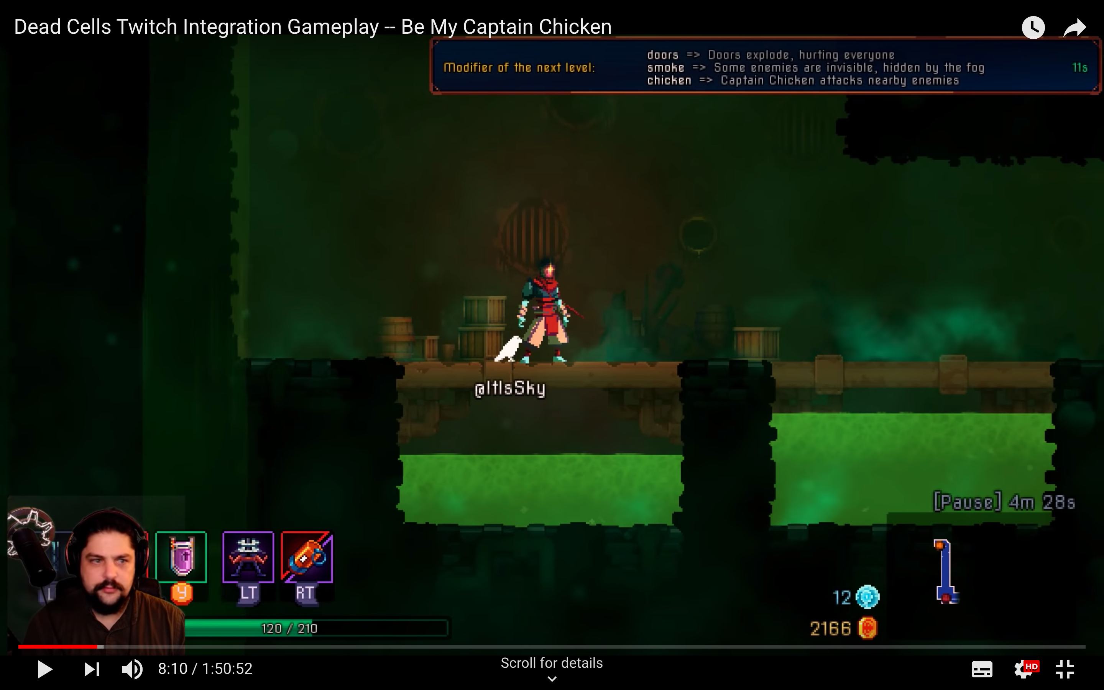
Dead Cells (Twitch Chat API)
https://venturebeat.com/2018/08/07/dead-cells-twitch-integration-is-great/
#twitchmygame
Richard Deveraux
@lowlines
Notes:
Bird companion (Captain Chicken)
- Has the viewer’s name
- Can attack enemies with lightning
- Can heal the streamer

Slide 29
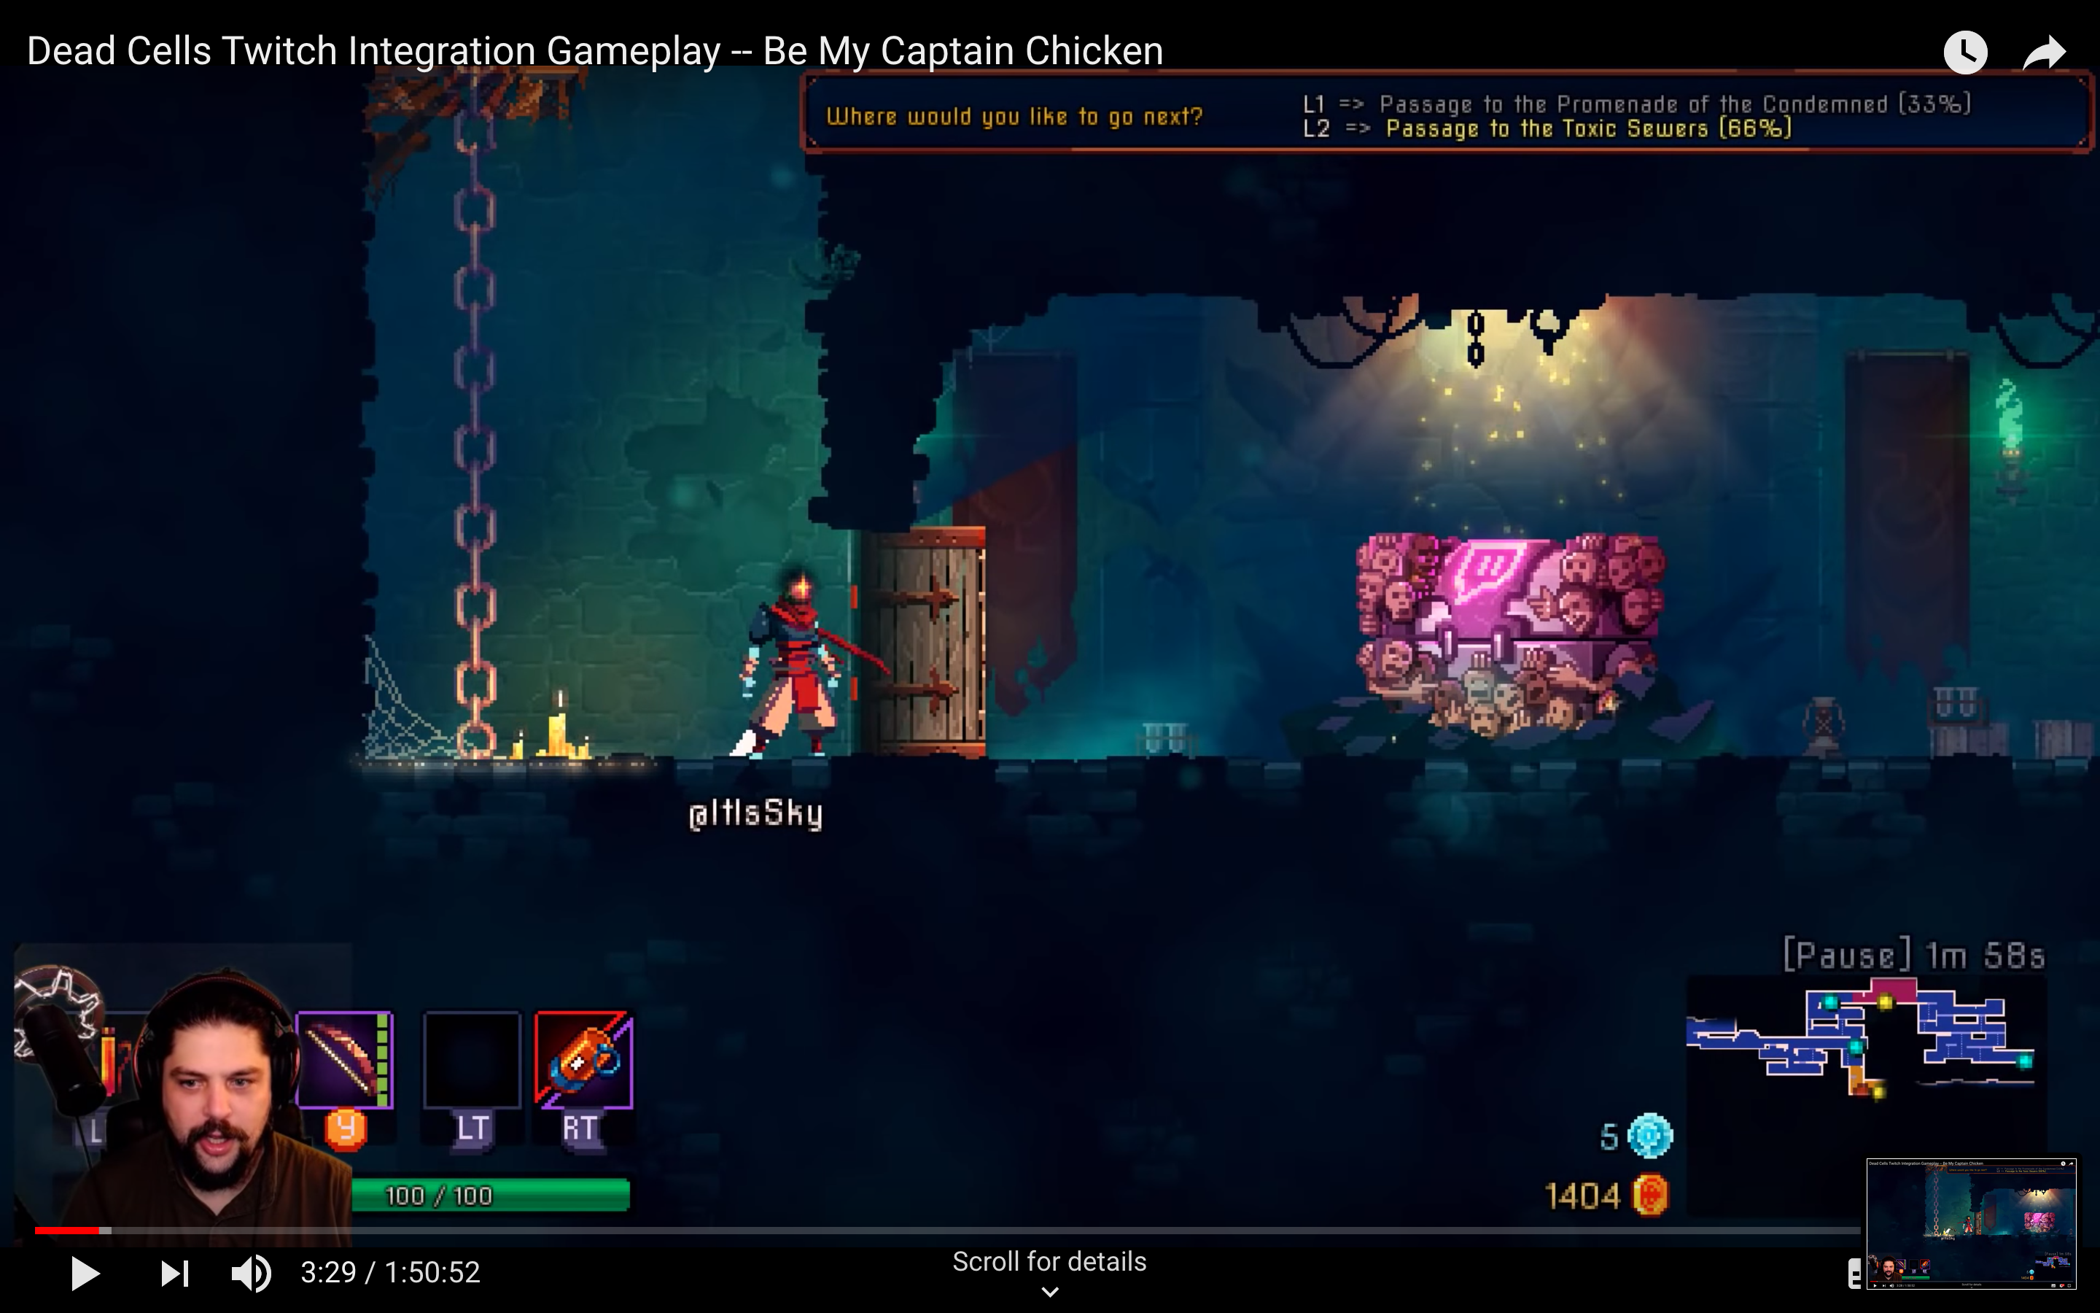
Dead Cells (Twitch Chat API)
https://venturebeat.com/2018/08/07/dead-cells-twitch-integration-is-great/
#twitchmygame
Richard Deveraux
@lowlines
Notes:
Twitch chests appear in-game, viewers have to use text commands to open it

Slide 30
Dead Cells (Twitch Chat API)
https://venturebeat.com/2018/08/07/dead-cells-twitch-integration-is-great/
#twitchmygame
Richard Deveraux
@lowlines
Notes:
Viewers can vote on level modifiers

Slide 31
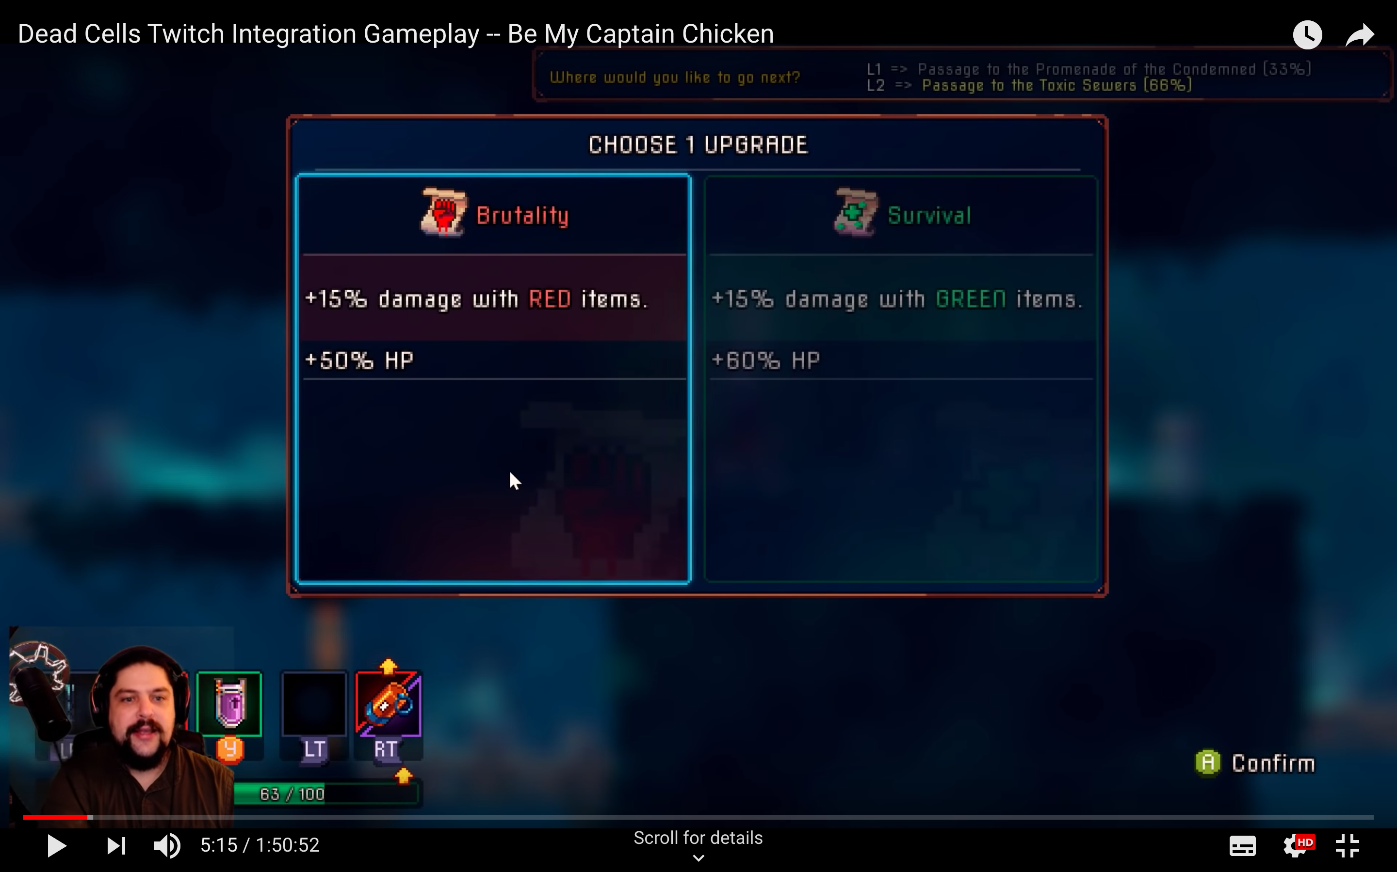
Dead Cells (Twitch Chat API)
https://venturebeat.com/2018/08/07/dead-cells-twitch-integration-is-great/
#twitchmygame
Richard Deveraux
@lowlines
Notes:
Viewers get to pick how the streamer upgrades their character, streamer gets the final say on user voted choices

Slide 32
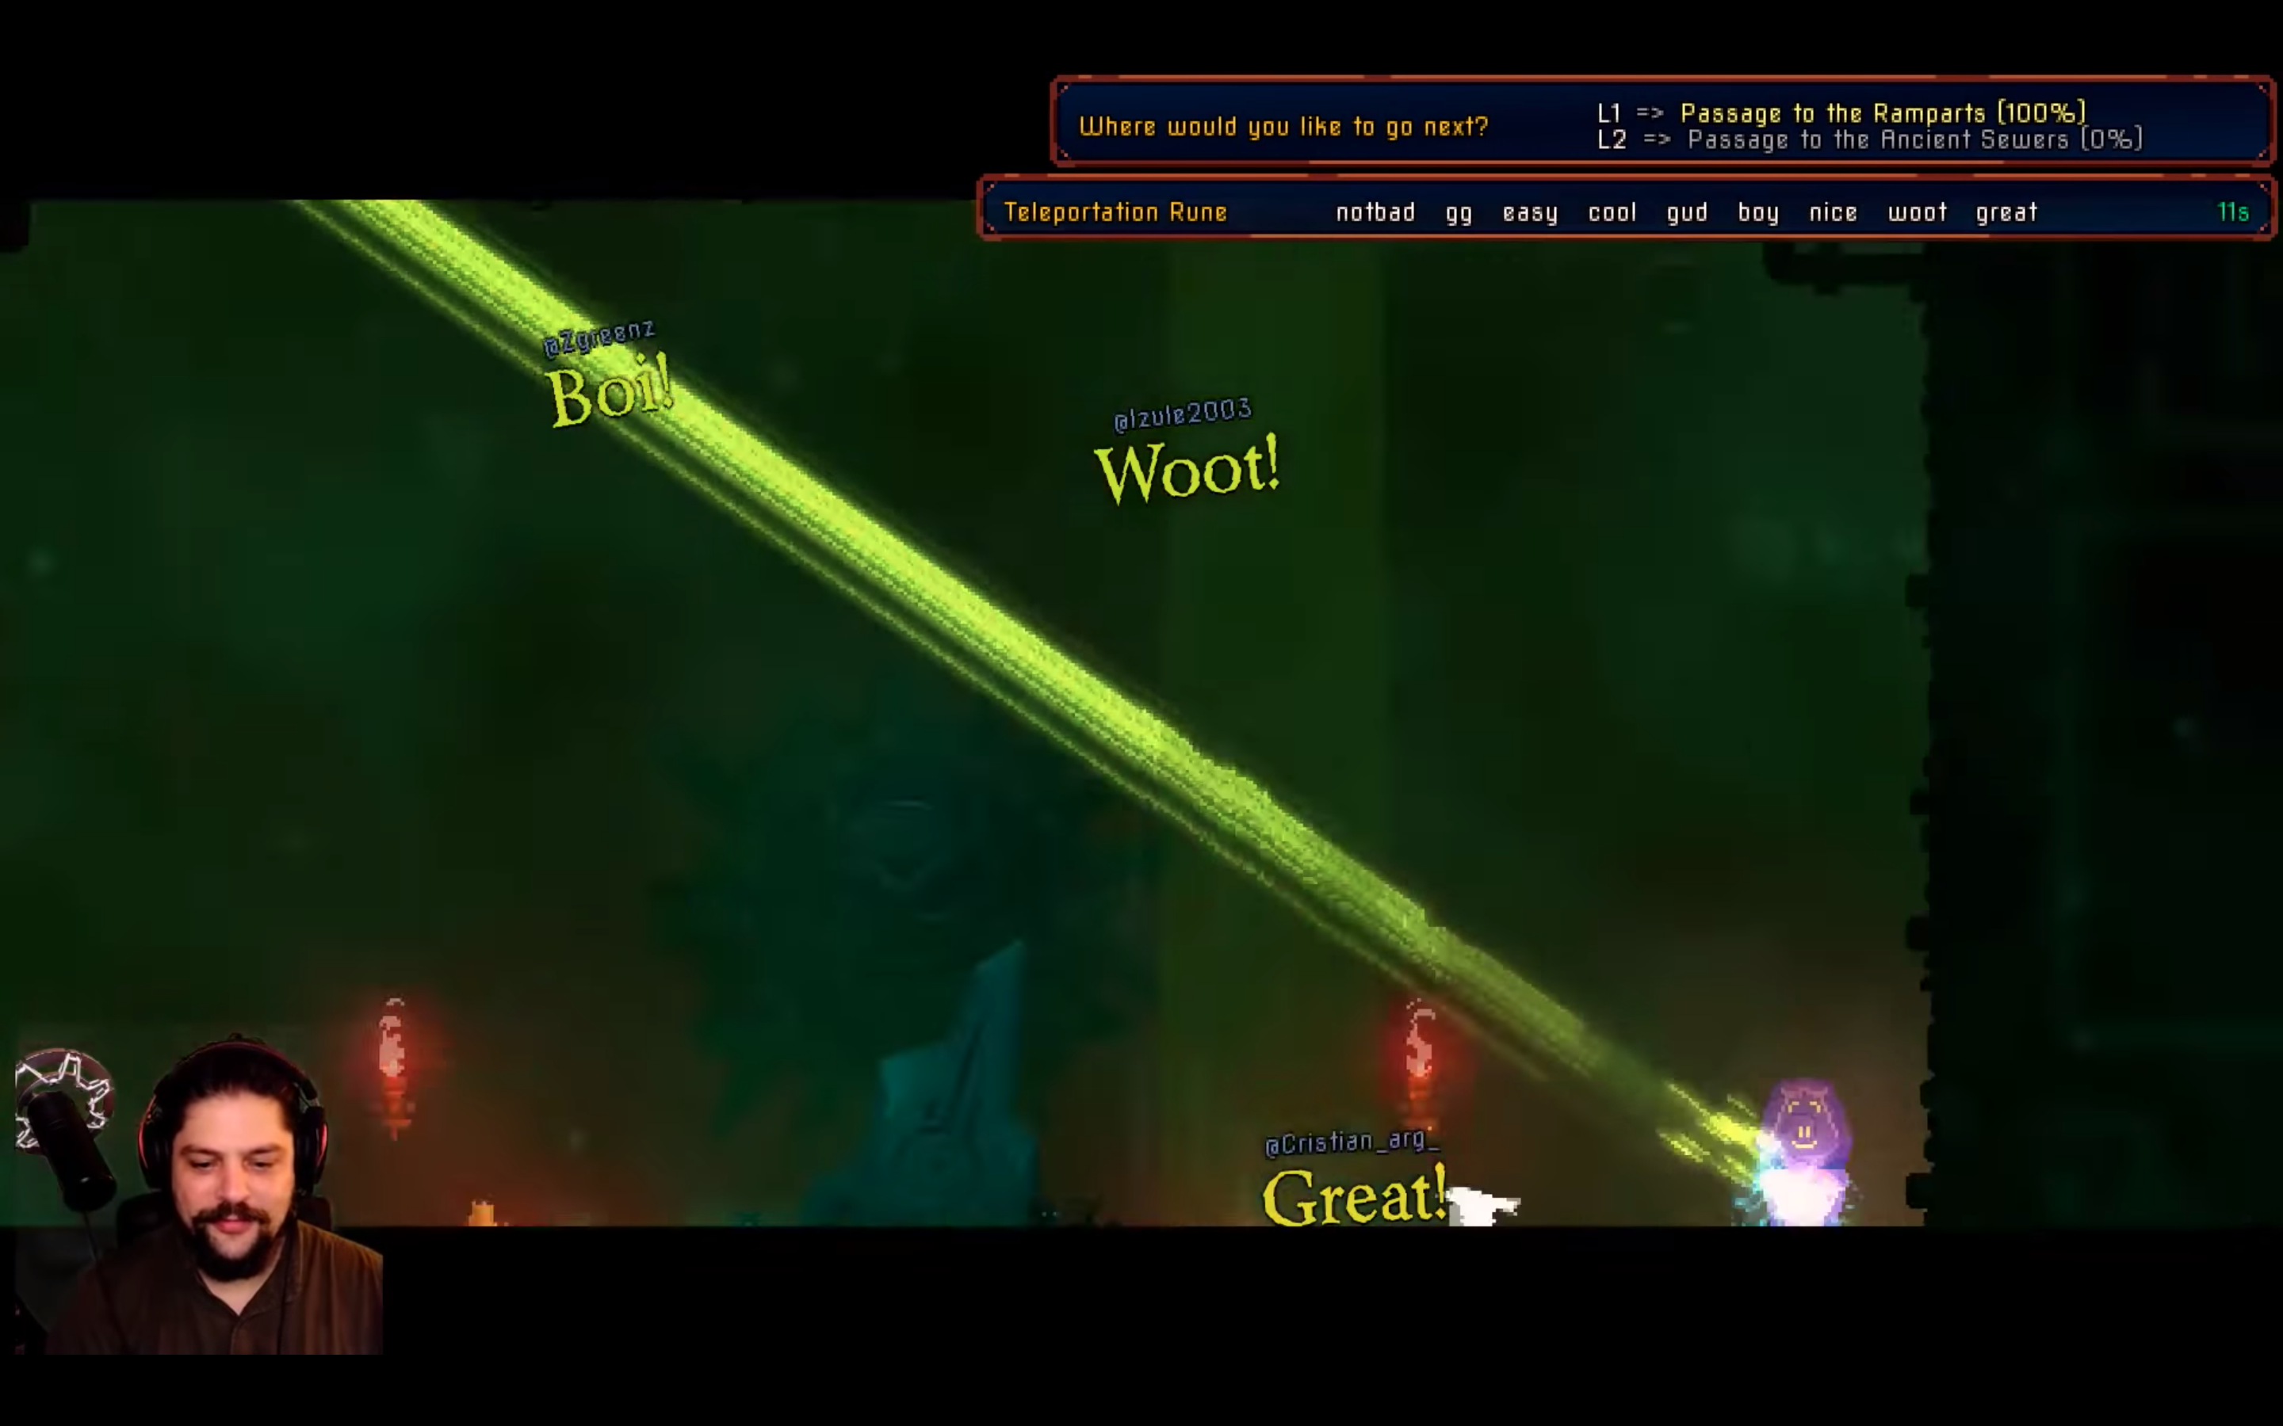
Dead Cells (Twitch Chat API)
https://venturebeat.com/2018/08/07/dead-cells-twitch-integration-is-great/
#twitchmygame
Richard Deveraux
@lowlines
Notes:
Viewers can post on-screen messages to taunt/congratulate the streamer

Slide 33

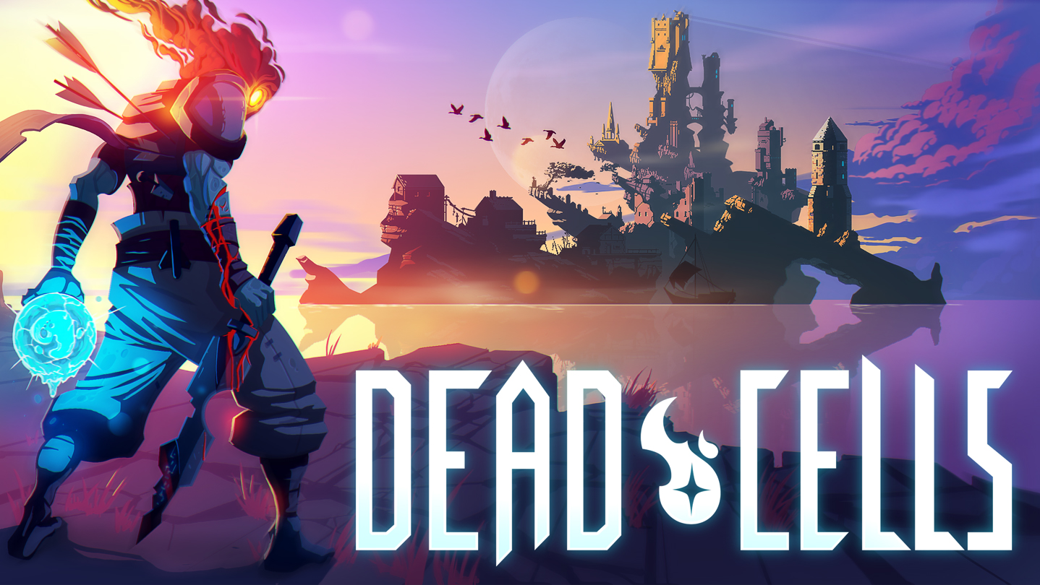
Dead Cells (Twitch Chat API)
#twitchmygame
Richard Deveraux
@lowlines
Notes:
I would personally love to see what the experience would be like if it was built as a dedicated Twitch Extension (I would even offer to build it)

Slide 34
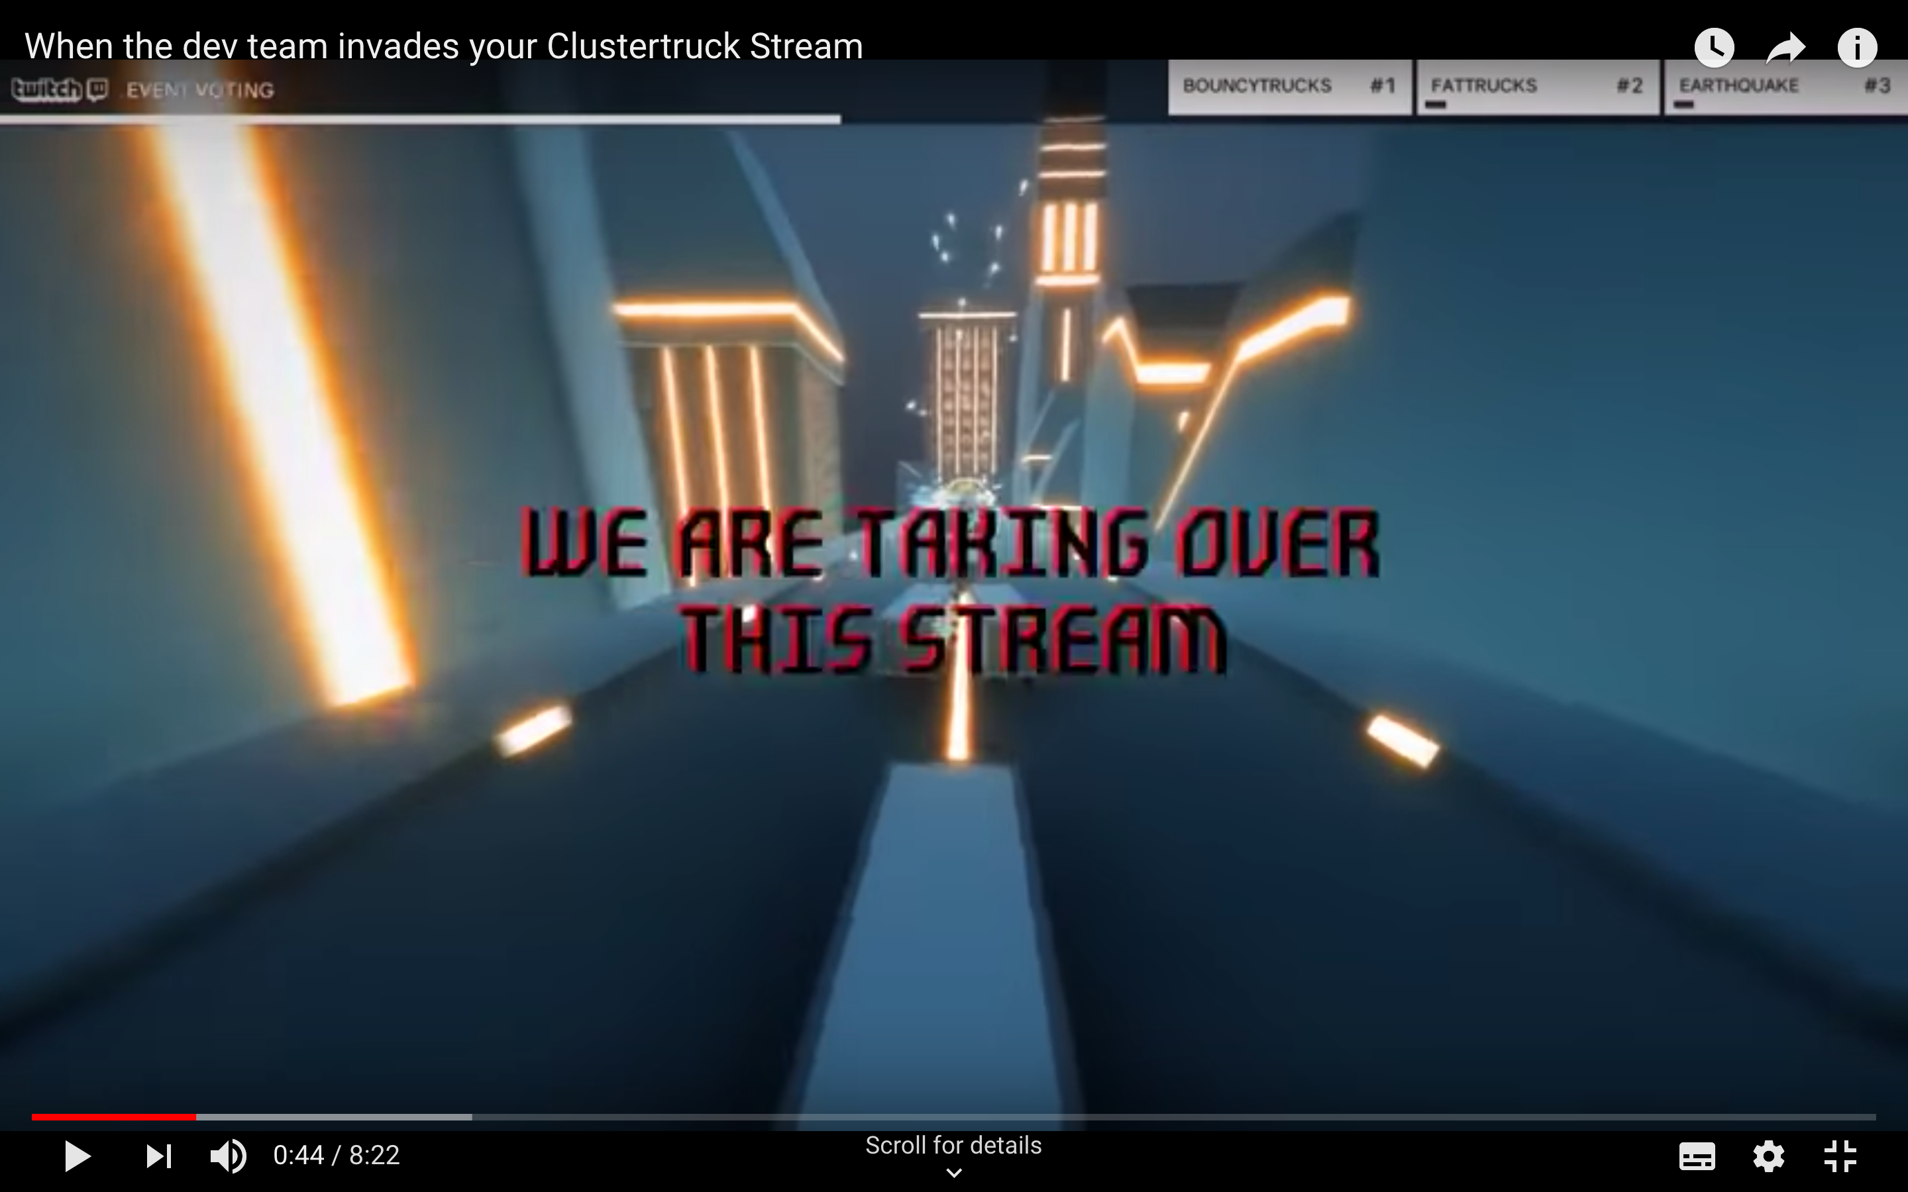
Clustertruck
https://www.youtube.com/watch?v=6SUj7nRmX0E
#twitchmygame
Richard Deveraux
@lowlines
Notes:
Clustertruck by Landfall added a way for the devs to hijack the streamer’s game and make on the fly changes

Slide 35
Going Forward…
Lots of cool things being done with streaming
Extensions are the way to go!
Players become more aware as more AAA game companies develop their own Extensions
Think about how your game may be streamed
Promote your streaming functionality!!
#twitchmygame
Richard Deveraux
@lowlines
Notes:
A key thing I think a lot of extensions is not being thought about early on in a game’s life cycle
A lot of the really cool implementations I’ve heard about have gotten very little media coverage and are often not even promoted on the official website
If making a game more streamable is an afterthought, then it is likely too late and anything done will be nothing more than an experiment that won’t go anywhere, especially on the indie scale where there may not be a budget for it

Slide 36

Going Forward…
Closes 5pm EDT October 22
https://twitchdevjam.devpost.com/
#twitchmygame
Richard Deveraux
@lowlines
Notes:
Twitch is currently running s DevJam and the theme is building a game-matched extension (I’m building a Destiny extension that I hope to have ready by the submission date)

Slide 37
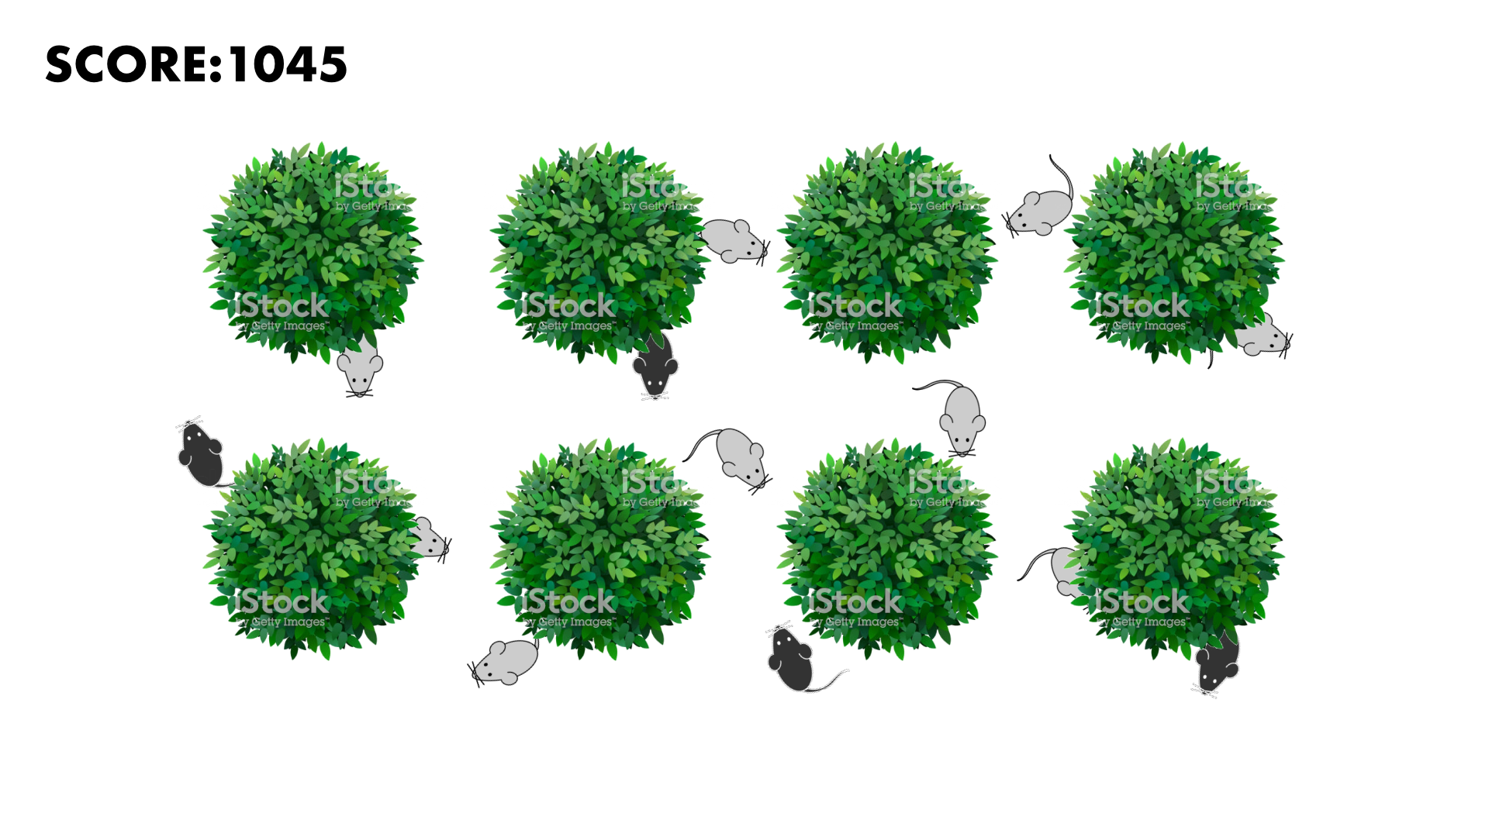
Built for Streaming
#twitchmygame
Richard Deveraux
@lowlines
Notes:
In this game the streamer has to remove mice that have invaded the garden, however they need to avoid the black mice or else they will lose points
The streamer doesn’t know where the mice are until they make a mad dash to another bush but the viewers can see everything via an Overlay Twitch Extension

Slide 38
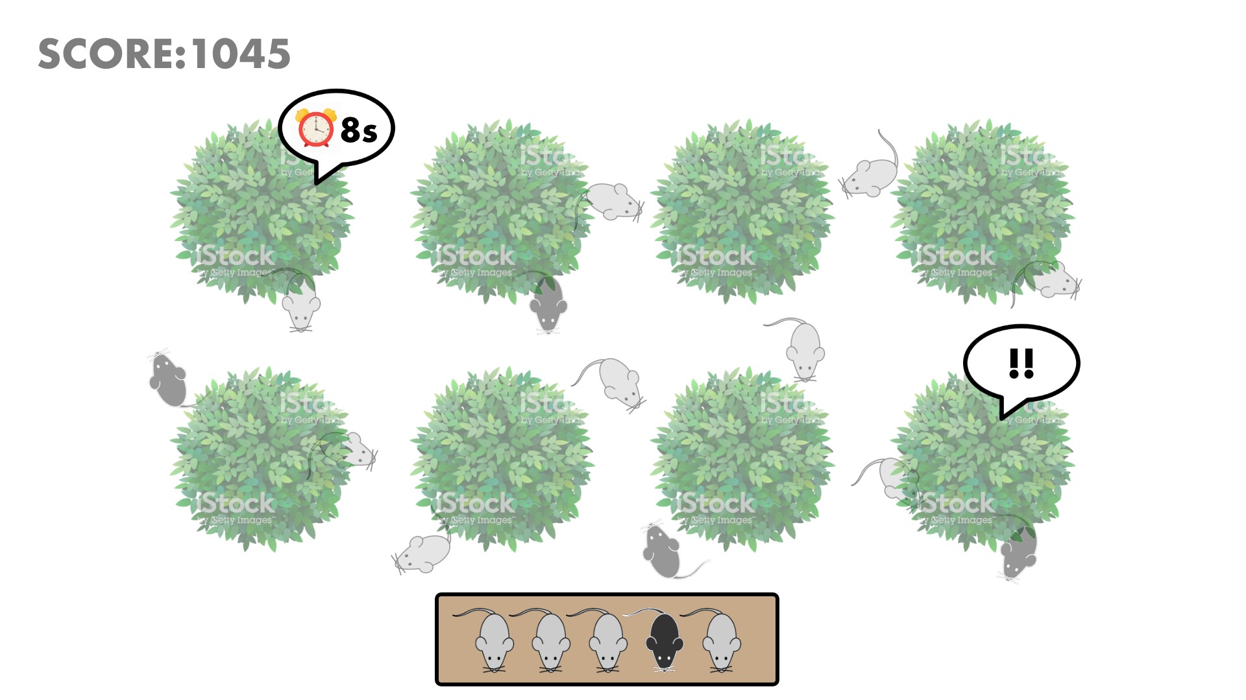
Built for Streaming
#twitchmygame
Richard Deveraux
@lowlines
Notes:
Viewers can also team up and spawn mice to compete with the streamer
This is an example of how you could utilize the Extensions platform to create an experience not currently possible. Your battle royale games are 1v100 but a streamer could potentially have thousands of concurrent viewers that could also choose to participate in the stream
Keep in mind, this type of experience would obviously not scale without a dedicated backend service, but this is just the beginning of what might be possible to stream integration
Planning to publish the game on itch.io/Twitch and release the source code once it is ready

Slide 39
Thanks for coming! Questions?
https://github.com/lowlines/gcap2019
#twitchmygame
Richard Deveraux
@lowlines

